Slide 1
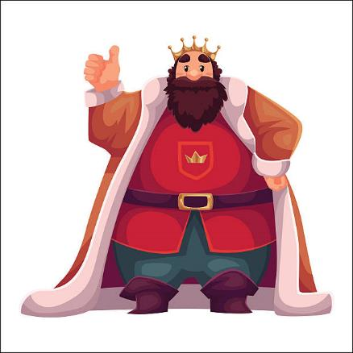
A Foolish Choice
Dig Site 7
1 Samuel 12:1-13:15

Slide 2

Hide it in your
But be sure to fear the Lord and serve him faithfully with all your heart;
consider what great things
he has done for you.
1 Samuel 12:24
DigSite #7

Slide 3


Hide it in your
For God is the King
of all the earth;
sing to him
a psalm of praise.
Psalm 47:7
DigSite #6

Slide 4
Hide it in your
Look to the Lord and His strength;
Seek His face always.
Remember the wonders he has done,
His miracles,
And the judgements
He pronounced.
1 Chronicles 16:11-12
DigSite #5

Slide 5
Hide it in your
Your ways,
God are holy.
What god is
as great as our God?
Psalm 77:13
DigSite #4

Slide 6

Samuel said to all Israel,
“I have listened to everything you said to me and have set a king over you.

Slide 7
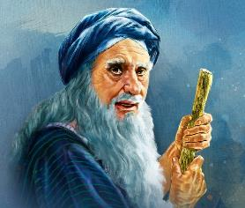
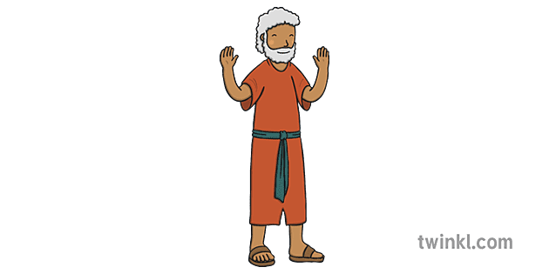

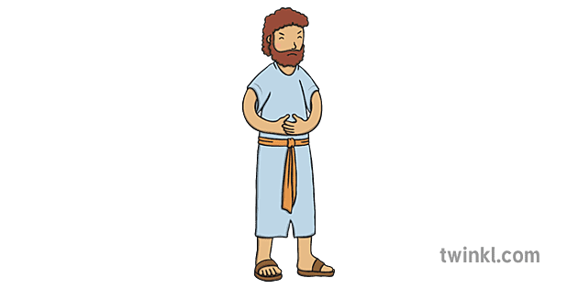

Now you have a king as your leader.
As for me, I am old and gray, and my sons are here with you.
I have been your leader from my youth until this day.
Eli’s sons
Today
Youth
Joel

Slide 8
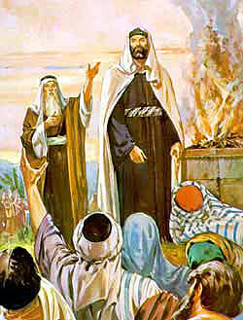
Here I stand. Testify against me in the presence of the Lord and his anointed.

Slide 9
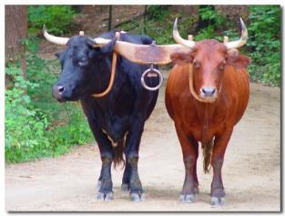
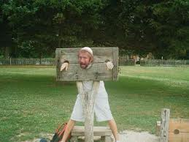
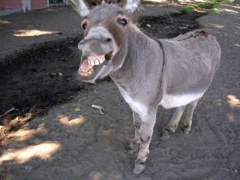
Whose ox have I taken?
Whose donkey have I taken?
Whom have I cheated?
Whom have I oppressed?

Slide 10
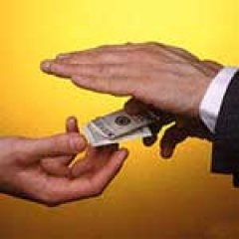
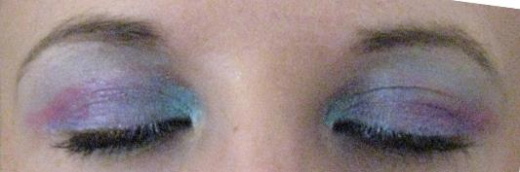
From whose hand have I accepted a bribe to make me shut my eyes? If I have done any of these things, I will make it right.”

Slide 11

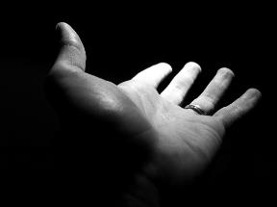
“You have not cheated or oppressed us,” they replied.
“You have not taken anything from anyone’s hand.”
X

Slide 12
Samuel said to them, “The Lord is witness against you, and also his anointed is witness this day, that you have not found anything in my hand.”
“He is witness,” they said.
X

Slide 13
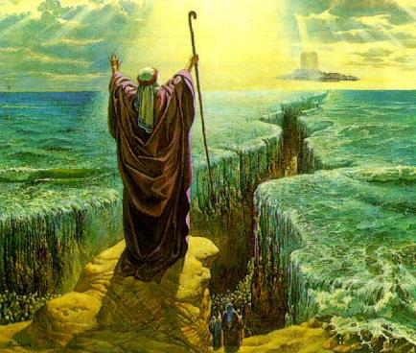
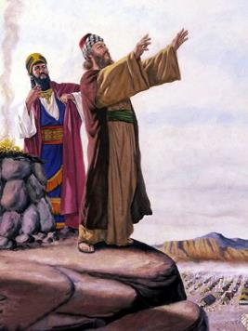
Then Samuel said to the people,
“It is the Lord who appointed Moses and Aaron and brought your ancestors up out of Egypt.

Slide 14
Now then, stand here, because I am going to confront you with evidence before the Lord as to all the righteous acts performed by the Lord for you and your ancestors.
Righteous Acts from the LORD

Slide 15
“After Jacob entered Egypt, they cried to the Lord for help, and the Lord sent Moses and Aaron, who brought your ancestors out of Egypt and settled them in this place.
Help us, LORD!

Slide 16
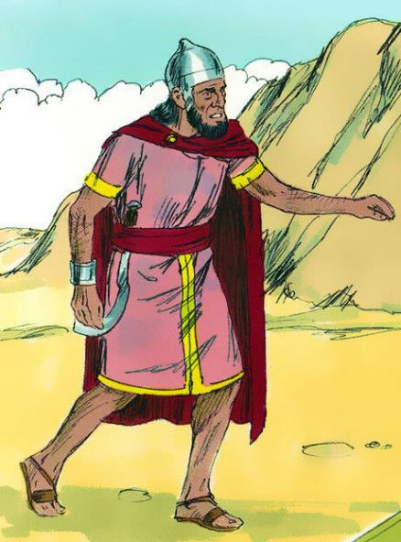
“But they forgot the Lord their God; so he sold them into the hand of Sisera, the commander of the army of Hazor,

Slide 17
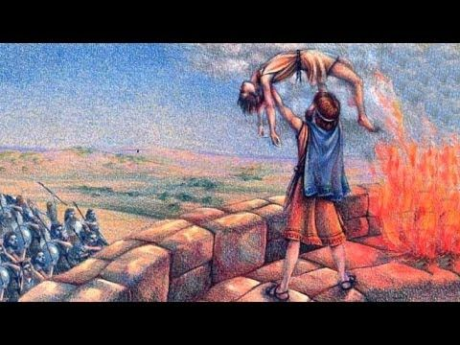
and into the hands of the Philistines and the king of Moab, who fought against them.

Slide 18
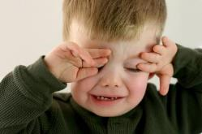
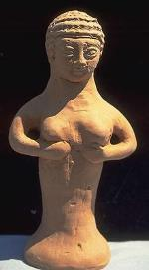
They cried out to the Lord and said,
‘We have sinned; we have forsaken the Lord and served the Baals and the Ashtoreths.

Slide 19
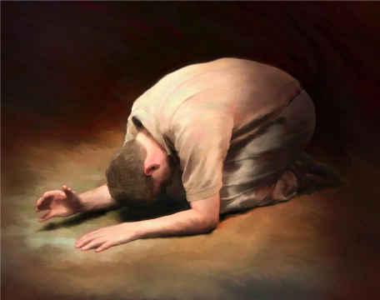
But now deliver us from the hands of our enemies,
and we will serve you.’

Slide 20
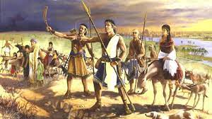
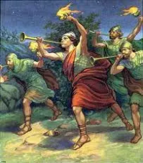
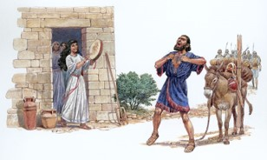
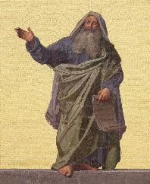
Then the Lord sent Jerub-Baal,
Barak,
Jephthah and Samuel, and he delivered you from the hands of your enemies all around you, so that you lived in safety.

Slide 21
“But when you saw that Nahash king of the Ammonites was moving against you, you said to me, ‘No, we want a king to rule over us’—even though the Lord your God was your king.
We want a king!!

Slide 22


Now here is the king you have chosen, the one you asked for; see, the Lord has set a king over you.
You asked for it…
your king!!!

Slide 23
If you fear the Lord and serve and obey him and do not rebel against his commands, and if both you and the king who reigns over you follow the Lord your God—good!
You asked for it…
your king!!!

Slide 24
But if you do not obey the Lord, and if you rebel against his commands, his hand will be against you, as it was against your ancestors.

Slide 25
“Now then, stand still and see this great thing the Lord is about to do before your eyes!

Slide 26
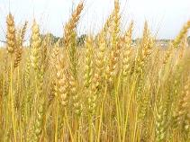
Is it not wheat harvest now?
I will call on the Lord to send thunder and rain. And you will realize what an evil thing you did in the eyes of the Lord when you asked for a king.”

Slide 27
Then Samuel called on the Lord, and that same day the Lord sent thunder and rain.
So all the people stood in awe of the Lord and of Samuel.

Slide 28
The people all said to Samuel, “Pray to the Lord your God for your servants so that we will not die, for we have added to all our other sins the evil of asking for a king.”

Slide 29
“Do not be afraid,” Samuel replied. “You have done all this evil; yet do not turn away from the Lord, but serve the Lord with all your heart.

Slide 30

Do not turn away after useless idols.
They can do you no good, nor can they rescue you, because they are useless.

Slide 31
For the sake of his great name the Lord will not reject his people, because the Lord was pleased to make you his own.

Slide 32
As for me, far be it from me that I should sin against the Lord by failing to pray for you.
And I will teach you the way that is good and right.
Good
and
Right

Slide 33
But be sure to fear the Lord and serve him faithfully with all your heart; consider what great things he has done for you.

Slide 34

Yet if you persist in doing evil, both you and your king will perish.”

Slide 35
Yet if you persist in doing evil, both you and your king will perish.”

Slide 36

Saul was thirty years old when he became king, and he reigned over Israel forty-two years.
Served 42 years
30 years old
72 years old

Slide 37
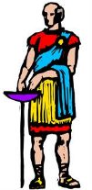
Saul chose three thousand men from Israel; two thousand were with him at Mikmash and in the hill country of Bethel, and a thousand were with Jonathan at Gibeah in Benjamin.
2,000 men
from Micmash
1,000 men with
Jonathan at Gibeah
3,000 total from Israel
Notes:
37

Slide 38

The rest of the men he sent back to their homes.

Slide 39
Jonathan attacked the Philistine outpost at Geba, and the Philistines heard about it. Then Saul had the trumpet blown throughout the land and said, “Let the Hebrews hear!”
Let the Hebrews hear!

Slide 40
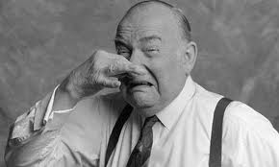
So all Israel heard the news:
“Saul has attacked the Philistine outpost, and now Israel has become obnoxious to the Philistines.” And the people were summoned to join Saul at Gilgal.
Attacked!

Slide 41
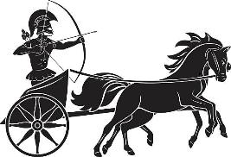
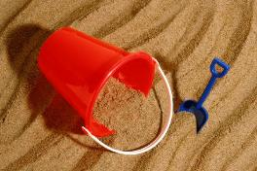
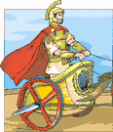
The Philistines assembled to fight Israel, with three thousand chariots, six thousand charioteers, and soldiers as numerous as the sand on the seashore.
3,000
chariots
6,000
charioteers
Soldiers = more than you can count

Slide 42
They went up and camped at Mikmash, east of Beth Aven.
N
Beth Aven
W
East
Mikmash
S

Slide 43
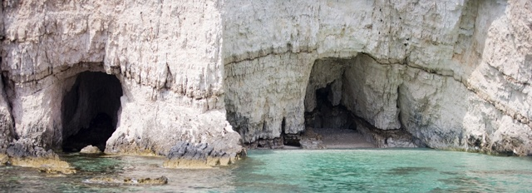
When the Israelites saw that their situation was critical and that their army was hard pressed, they hid in caves and thickets, among the rocks, and in pits and cisterns.

Slide 44
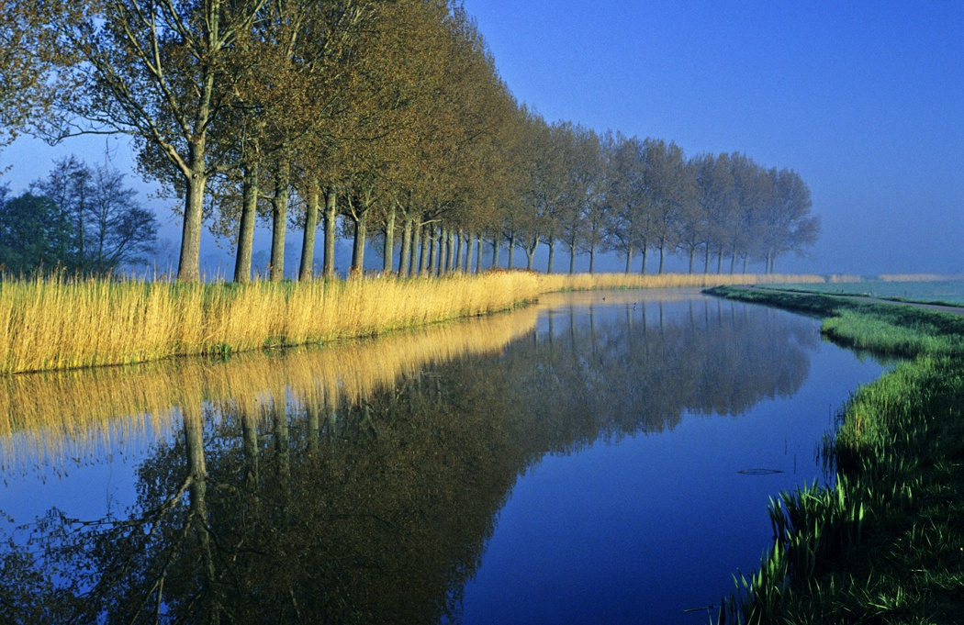
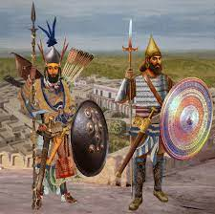
Some Hebrews even crossed the Jordan
to the land of Gad and Gilead.
Gad and Gilead

Slide 45

Saul remained at Gilgal, and all the troops with him were quaking with fear.

Slide 46
He waited seven days, the time set by Samuel; but Samuel did not come to Gilgal, and Saul’s men began to scatter.
7

Slide 47
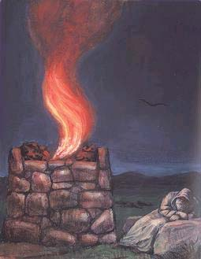
So he said,
“Bring me the burnt offering and the fellowship offerings.”
And Saul offered up the burnt offering.

Slide 48

Just as he finished making the offering, Samuel arrived, and Saul went out to greet him.
“What have you done?” asked Samuel.
Samuel
Saul, what have you done?

Slide 49
Saul replied, “When I saw that the men were scattering, and that you did not come at the set time, and that the Philistines were assembling at Mikmash,

Slide 50
I thought,
‘Now the Philistines will come down against me at Gilgal, and I have not sought the Lord’s favor.’
So I felt compelled to offer the burnt offering.”

Slide 51
I didn’t ask God…uh…I think I goofed.

Slide 52

“You have done a foolish thing,” Samuel said. “You have not kept the command the Lord your God gave you; if you had, he would have established your kingdom over Israel for all time.

Slide 53
But now your kingdom will not endure; the Lord has sought out a man after his own heart and appointed him ruler of his people, because you have not kept the Lord’s command.”
You’re out, he’s in!

Slide 54

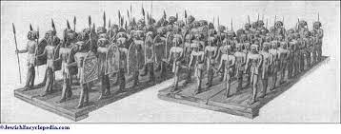
Then Samuel left Gilgal and went up to Gibeah in Benjamin, and Saul counted the men who were with him.
They numbered about six hundred.
Gibeah
Gilgal
600 men

