Slide 1
DigSite #2
Acts
3:1-16
4:1-22

Slide 2
Better than Money

Slide 3
Memory
Verse
Acts 4:12
Salvation is found in no one else,
for there is no other name under heaven
given to mankind
by which we must be saved.
DS #2

Slide 4
Peter Heals the Lame Beggar
Acts
3:1-10

Slide 5
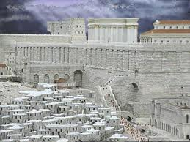
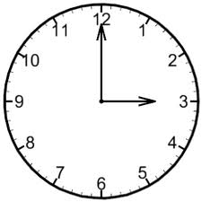
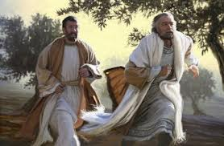
One day Peter and John were going up to the temple at the time of prayer—at three in the afternoon.

Slide 6
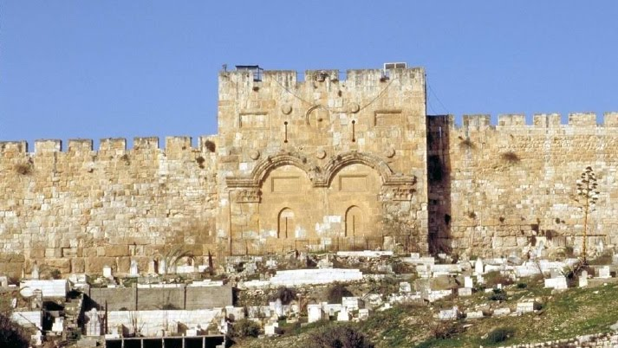
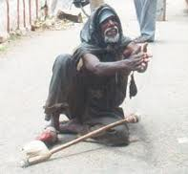
Now a man crippled from birth was being carried to the temple gate called Beautiful, where he was put every day to beg from those going into the temple courts.

Slide 7
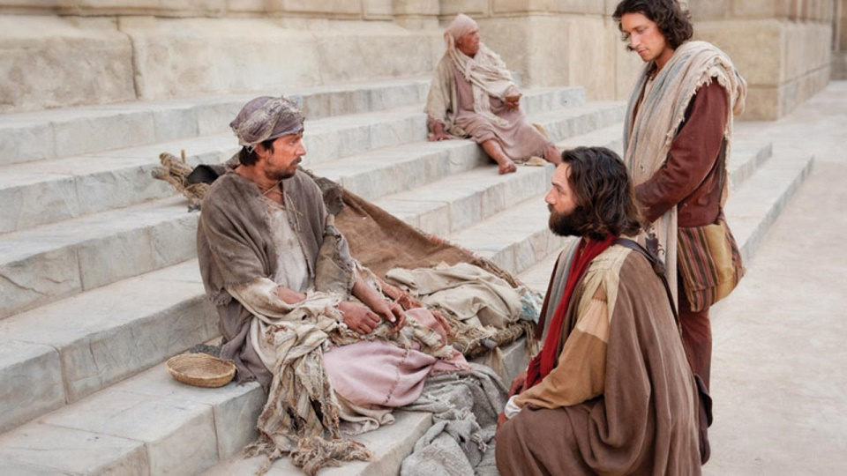
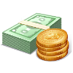

When he saw Peter and John about to enter, he asked them for money.
Peter looked straight at him, as did John.
Then Peter said,
“Look at us!”
So the man gave them his attention*, expecting to get something from them.

Slide 8


Then Peter said, “Silver or gold I do not have*, but what I have I give you.
In the name of Jesus Christ* of Nazareth, walk.”

Slide 9
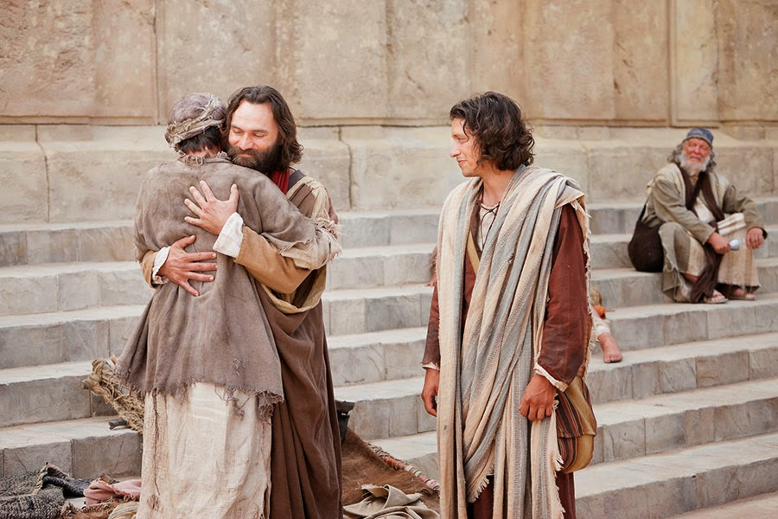
Taking him by the right hand, he helped him up, and instantly the man’s feet and ankles became strong.

Slide 10
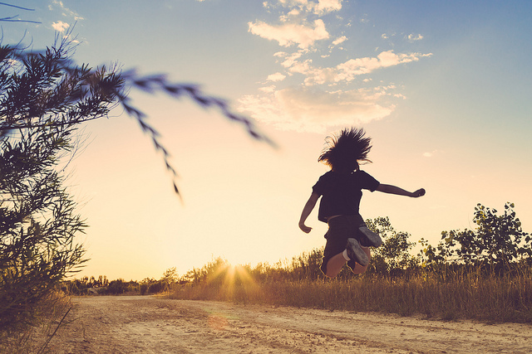
He jumped to his feet and began to walk. Then he went with them into the temple courts, walking and jumping, and praising God.

Slide 11
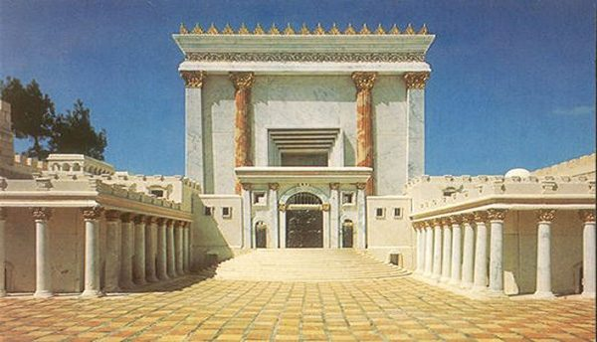
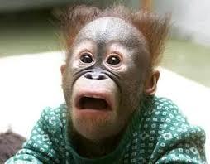
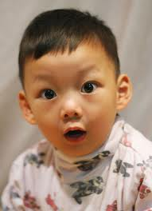

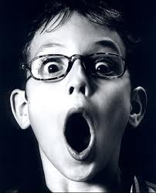
When all the people saw him walking and praising God, they recognized him as the same man who used to sit begging at the temple gate called Beautiful, and they were filled with wonder and amazement at what had happened to him.

Slide 12
Peter Speaks to the Onlookers
Acts
3:11-16

Slide 13
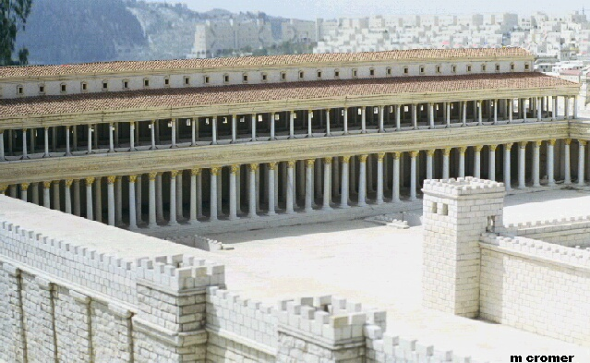
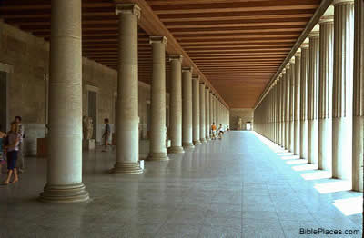
While the beggar held on to Peter and John, all the people were astonished and came running to them in the place called Solomon’s Colonnade.
A covered walkway along the eastern wall of the Temple

Slide 14
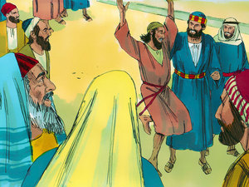
When Peter saw this, he said to them:
“Fellow Israelites, why does this surprise you?
Why do you stare at us as if by our own power or godliness we had made this man walk?

Slide 15
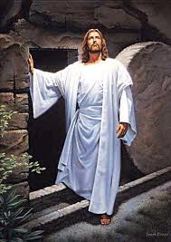
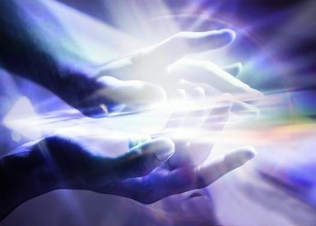
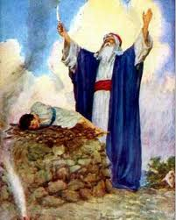
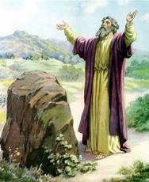
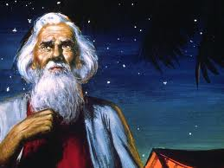
The God of Abraham*,
Isaac* and Jacob*,
the God of our fathers*,
has glorified his servant Jesus*.

Slide 16
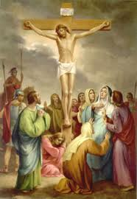
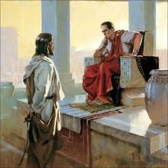
You handed him over to be killed, and you disowned him before Pilate, though he had decided to let him go.

Slide 17
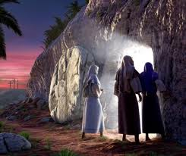
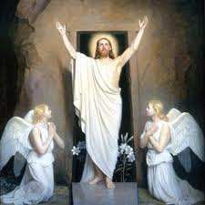
You disowned the Holy and Righteous One and asked that a murderer be released to you.
You killed the author of life, but God raised him from the dead.
We are witnesses of this.

Slide 18
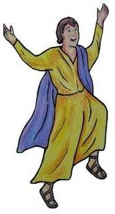

By faith in the name of Jesus, this man whom you see and know was made strong. It is Jesus’name and the faith that comes through him that has given this complete healing to him, as you can all see.

Slide 19
Peter and John Arrested
Acts
4:1-4

Slide 20
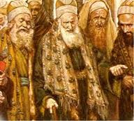
The priests and the captain of the temple guard and the Sadducees came up to Peter and John while they were speaking to the people.
They were greatly disturbed because the apostles were teaching the people and proclaiming in Jesus the resurrection of the dead*.
Sadducees did not believe in the resurrection of the body, that the soul lasts forever, or that spirits and angels exist because Moses never mentioned those things in his writings.

Slide 21
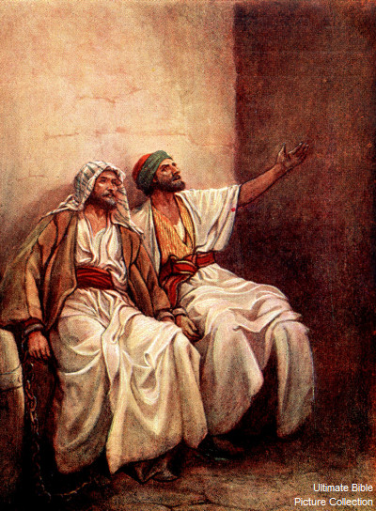
They seized Peter and John and, because it was evening, they put them in jail until the next day.

Slide 22
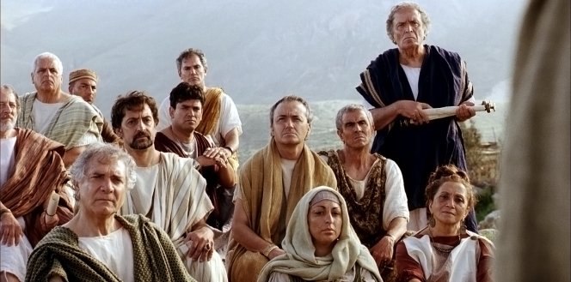
But many who heard the message believed, and the number of men grew
to about
5000.
5000!? That’s a lot of men! I wonder how many women and children joined the group?

Slide 23
Peter and John Before the Sanhedrin
Acts
4:5-22

Slide 24
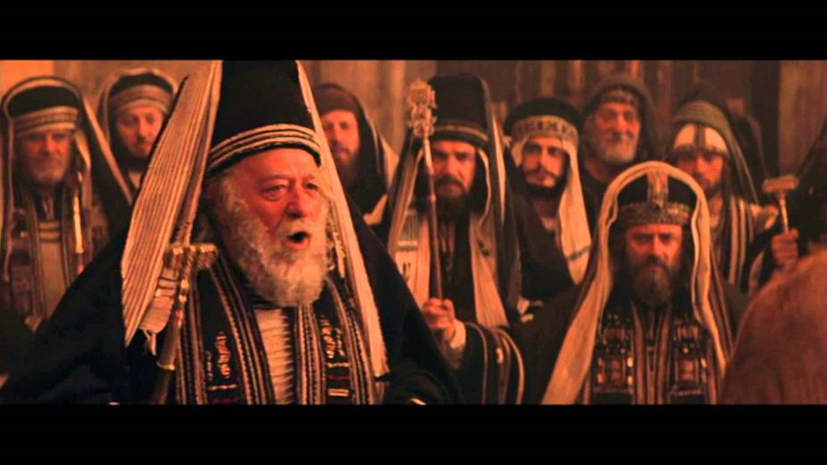
The next day the rulers, elders and teachers of the law met in Jerusalem.
Sanhedrin – the highest ruling Jewish court of justice

Slide 25
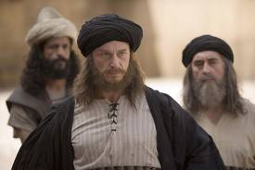
He’s the guy in charge.
Married Annas’ daughter, plotted Jesus’ arrest, and presided at trial
Annas the high priest was there, and so were Caiaphas, John, Alexander and the others of the high priest’s family.

Slide 26
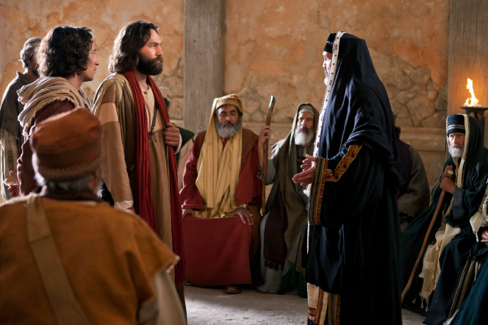
By what power or what name did you do this?
They had Peter and John brought before them and began to question them.

Slide 27
Then Peter, filled with the Holy Spirit, said to them…

Slide 28
Rulers and elders of the people! If we are being called to account today for an act of kindness shown to a man who was lame and are being asked how he was healed, then know this, you and all the people of Israel:

Slide 29
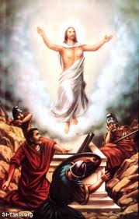
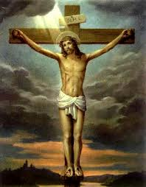
It is by the name of Jesus Christ* of Nazareth, whom you crucified but whom God raised from the dead*, that this man stands before you healed.

Slide 30
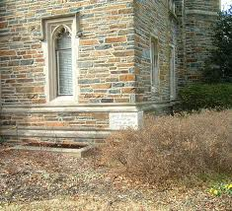
Jesus is
“‘the stone you builders rejected,
which has become
the cornerstone.
Salvation is found in no one else, for there is no other name under heaven given
to mankind by which we must be saved.”
(Psalm 118:22)

Slide 31
How do they know all this? They don’t have any education.
When they saw the courage of Peter and John and realized that they were unschooled, ordinary men, they were astonished and they took note that these men had been with Jesus*.
Hey! These guys were with Jesus!

Slide 32

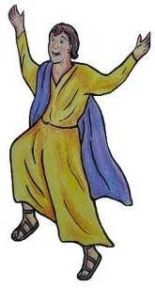
But since they could see the man who had been healed standing there with them, there was nothing they could say.
same guy
Guess there’s nothing else to say since the guy’s standing here.

Slide 33
So they ordered them to withdraw from the Sanhedrin and then conferred together.
You guys need to get out while we talk about you.

Slide 34
What are we going to do with these men?” they asked. “Everyone living in Jerusalem knows they have performed a notable sign, and we cannot deny it.
But to stop this thing from spreading any further among the people, we must warn them to speak no longer to anyone in this name.

Slide 35
Then they called them in again and commanded them…
or you’ll be in BIG trouble!
Do not to speak or teach at all in the name of Jesus.

Slide 36
But Peter and John replied…
Which is right in God’s eyes: to listen to you, or to him?
You be the judges!
As for us we cannot help speaking about what we have seen and heard.

Slide 37
After further threats they let them go. They could not decide how to punish them, because all the people were praising God for what had happened.
For the man who was miraculously healed was over forty years old.
We’ll throw you in jail again!
You’ll get beaten up!

