Slide 1
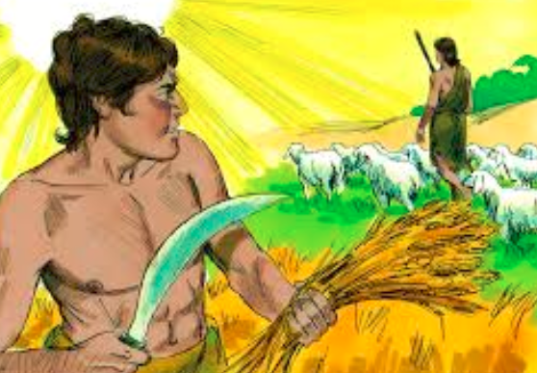
Dig Site #3
Genesis
4:1-16, 25-26

Slide 2
Adam made love to his wife Eve, and she became pregnant and gave birth to Cain.
She said, "With the help of the LORD I have brought forth a man."
Later she gave birth to his brother Abel.
Cain
Abel

Slide 3
Now Abel kept flocks,
and Cain worked the soil.
Abel
Cain

Slide 4

Answers are on the next screen.
Who was the oldest of Adam and Eve’s sons?
1. Abel
2. Seth
3. Cain

Slide 5
Who was the oldest of Adam and Eve’s sons?
1. Abel
2. Seth
3. Cain

Slide 6
What job did Cain have?
1. He kept flocks.
2. He worked the soil.
3. He worked by the water.

Slide 7
What job did Cain have?
1. He kept flocks.
2. He worked the soil.
3. He worked by the water.

Slide 8
What job did Abel have?
1. He worked by the water
2. He worked the soil.
3. He kept flocks.

Slide 9
What job did Abel have?
1. He worked by the water
2. He worked the soil.
3. He kept flocks.

Slide 10
In the course of time Cain brought some of the fruits of the soil as an offering to the LORD.
And Abel also brought an offering- fat portions from some of the firstborn of his flock.

Slide 11
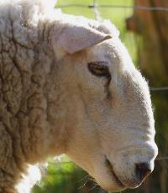
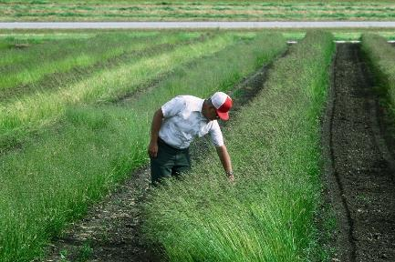
The LORD looked with favor on Abel and his offering,
but on Cain and his offering he did not look with favor.
So Cain was very angry, and his face was downcast.
Abel
Cain

Slide 12
Then the LORD said to Cain,
"Why are you angry? Why is your face downcast?
If you do what is right,
will you not be accepted?
?

Slide 13

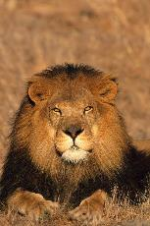
Memory Verse #3
Genesis 4:7b
But if you do not do what is right,
sin is crouching at your door; it desires to
have you,
but you must rule over it.“

Slide 14
With whose offering was the Lord pleased?
1. Cain’s
2. Adam’s
3. Abel’s

Slide 15
With whose offering was the Lord pleased?
1. Cain’s
2. Adam’s
3. Abel’s

Slide 16
Why was Cain angry?
1. The Lord did not look on his offering with favor.
2. The Lord looked with favor on
Abel’s offering.
3. Both answers are correct.

Slide 17
Why was Cain angry?
1. The Lord did not look on his offering with favor.
2. The Lord looked with favor on
Abel’s offering.
3. Both answers are correct.

Slide 18
What did the Lord say Cain must master?
1. gardening
2. sin
3. both answers are correct

Slide 19
What did the Lord say Cain must master?
1. gardening
2. sin
3. both answers are correct

Slide 20
What did Abel bring as an offering?
1. Fat portions of the first born of his flock.
2. Some of the fruits of the soil.
3. His brother.
4. All of the above.

Slide 21
What did Abel bring as an offering?
1. Fat portions of the first born of his flock.
2. Some of the fruits of the soil.
3. His brother.
4. All of the above.

Slide 22
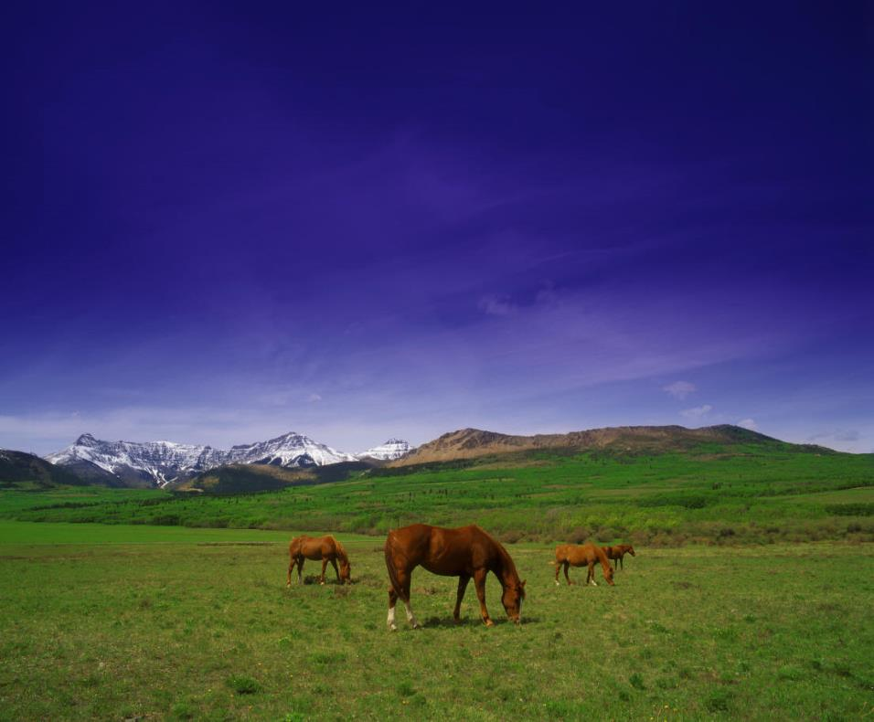
Now Cain said to his brother Abel, "Let's go out to the field."
While they were in the field, Cain attacked his brother Abel and killed him.

Slide 23
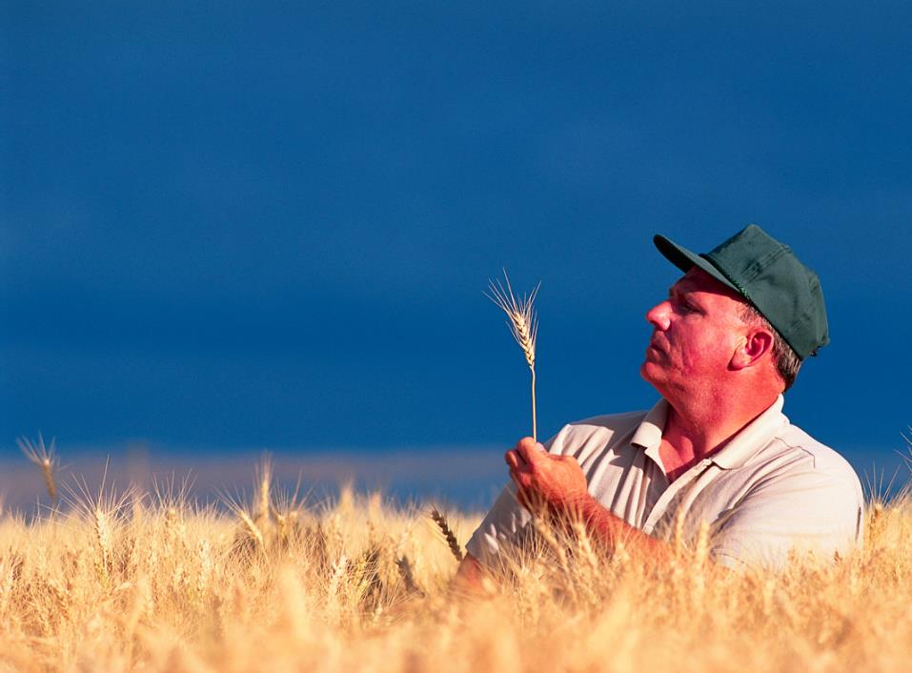
Then the LORD said to Cain,
"Where is your brother Abel?"
"I don't know," he replied.
"Am I my brother's keeper?"

Slide 24
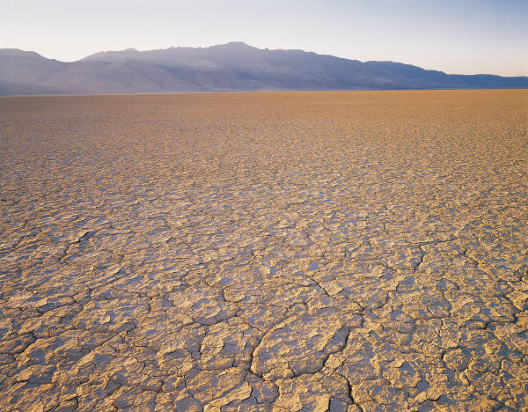
The LORD said, "What have you done? Listen! Your brother's blood cries out to me from the ground.
Now you are under a curse and driven from the ground, which opened its mouth to receive your brother's blood from your hand.

Slide 25

When you work the ground, it will no longer yield its crops for you.
You will be a restless wanderer on the earth.

Slide 26
Cain said to the LORD, "My punishment is more than I can bear.
Today you are driving me from the land, and I will be hidden
from your presence;
I will be a restless wanderer on the earth, and whoever finds me will kill me."

Slide 27
But the LORD said to him, "Not so; anyone who kills Cain will suffer vengeance seven times over."
Then the LORD put a mark on Cain so that no one who found him would kill him.
So Cain went out from the LORD's presence and lived in the land of Nod, east of Eden.

Slide 28
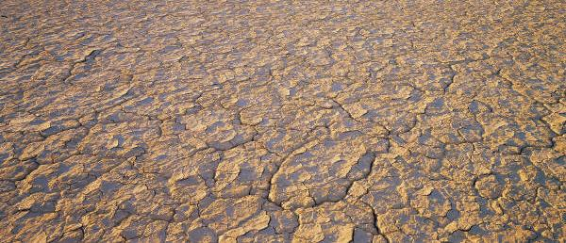
So Cain went out from the LORD's presence and lived in the land of Nod, east of Eden.

Slide 29
Why did the Lord punish Cain?
1. Cain attacked and killed his brother Abel.
2. Cain offered fish to the Lord.
3. Cain didn’t want to be a farmer.

Slide 30
Why did the Lord punish Cain?
1. Cain attacked and killed his brother Abel.
2. Cain offered fish to the Lord.
3. Cain didn’t want to be a farmer.

Slide 31
What was Cain’s punishment?
The ground wouldn’t grow crops for him.
2. He could never leave the Garden of Eden.
3. Both answers are correct

Slide 32
What was Cain’s punishment?
The ground wouldn’t grow crops for him.
2. He could never leave the Garden of Eden.
3. Both answers are correct

Slide 33
What did Cain say when the Lord asked where Abel was?
1. He’s in the pasture with the sheep.
2. He’s with our parents.
3. He’s with me working in the garden.
4. I don’t know. Am I my brother’s keeper?

Slide 34
What did Cain say when the Lord asked where Abel was?
1. He’s in the pasture with the sheep.
2. He’s with our parents.
3. He’s with me working in the garden.
4. I don’t know. Am I my brother’s keeper?

Slide 35
How was Cain punished for killing Abel?
1. He was driven from his home, and crops would not grow for him.
2. The Lord didn’t protect Cain from those who wanted to hurt him.
3. Cain would never be around other people.
4. All of the above.

Slide 36
How was Cain punished for killing Abel?
1. He was driven from his home, and crops would not grow for him.
2. The Lord didn’t protect Cain from those who wanted to hurt him.
3. Cain would never be around other people.
4. All of the above.

Slide 37
Adam made love to his wife again, and she gave birth to a son and named him Seth, saying, "God has granted me another child in place of Abel, since Cain killed him."

Slide 38

Seth also had a son, and he named him Enosh.
At that time people began to call on the name of the LORD.

Slide 39
Where did Cain go when he left?
1. Nod.
2. East of Eden.
3. Both answers are correct.

Slide 40
Where did Cain go when he left?
1. Nod.
2. East of Eden.
3. Both answers are correct.

Slide 41
When did people begin to call on the name of the Lord?
1. When they heard Abel was killed.
2. Before Abel was born.
3. After Seth was born and had a son.

Slide 42
When did people begin to call on the name of the Lord?
1. When they heard Abel was killed.
2. Before Abel was born.
3. After Seth was born and had a son.

Slide 43
What would happen to anyone who tried to kill Cain?
1. The Lord would punish that person.
2. That person would suffer vengeance seven times over.
3. The Lord would bless that person.
4. That person would suffer vengeance ten times over.

Slide 44
What would happen to anyone who tried to kill Cain?
1. The Lord would punish that person.
2. That person would suffer vengeance seven times over.
3. The Lord would bless that person.
4. That person would suffer vengeance ten times over.

Slide 45
What is the birth order of the three sons of Adam and Eve?
1. Seth, Abel and Cain.
2. Cain, Abel and Seth.
3. Abel, Cain and Seth.
4. None of the above.

Slide 46
What is the birth order of the three sons of Adam and Eve?
1. Seth, Abel and Cain.
2. Cain, Abel and Seth.
3. Abel, Cain and Seth.
4. None of the above.

