Slide 1

Genesis – Dig Site 7
Calls & Choices
Genesis 12:1-9; 13:5-18

Slide 2
Memory Verse
By faith Abraham, when called to go to a place he would later receive as his inheritance, obeyed and went, even though he did not know where he was going.
Hebrews 11:8

Slide 3
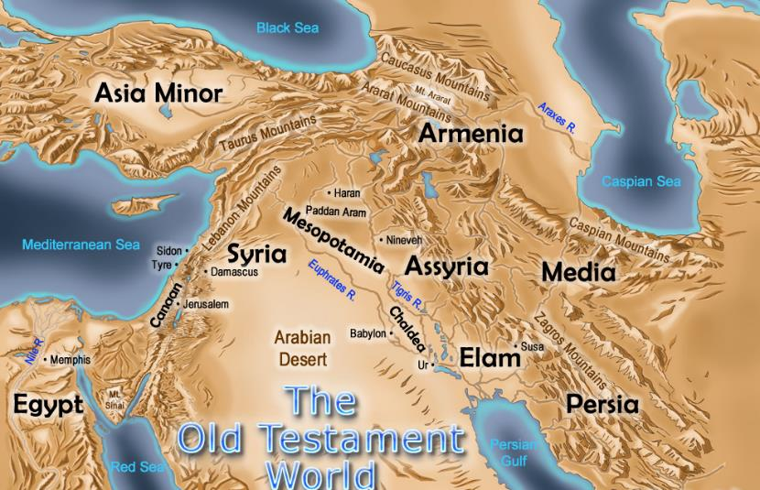
The Lord had said to Abram, “Go from your country, your people and your father’s household to the land I will show you.”

Slide 4
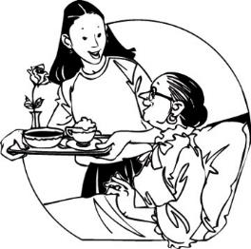
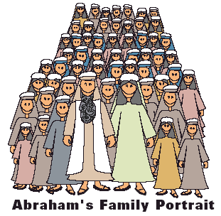

“I will make you into a great nation, and I will bless you;
I will make your name great, and you will be a blessing.
I will bless those who bless you, and whoever curses you I will curse; and all peoples on earth will be blessed through you.”

Slide 5
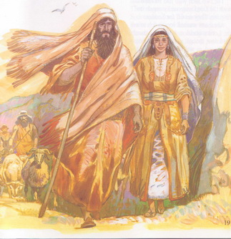
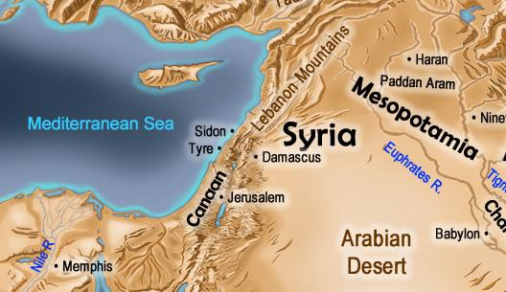
So Abram went, as the Lord had told him; and Lot went with him. Abram was seventy-five years old when he set out from Harran.
75

Slide 6
He took his wife Sarai, his nephew Lot, all the possessions they had accumulated and the people they had acquired in Harran, and they set out for the land of Canaan, and they arrived there.

Slide 7
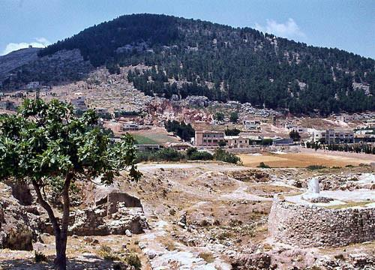
Abram traveled through the land as far as the site of the great tree of Moreh at Shechem. At that time the Canaanites were in the land.

Slide 8
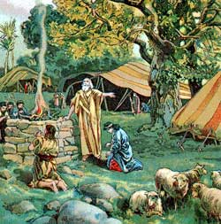
The Lord appeared to Abram and said, “To your offspring I will give this land.” So he built an altar there to the Lord, who had appeared to him.

Slide 9
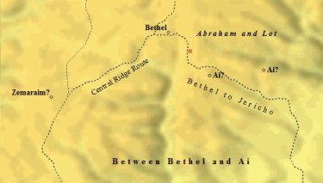
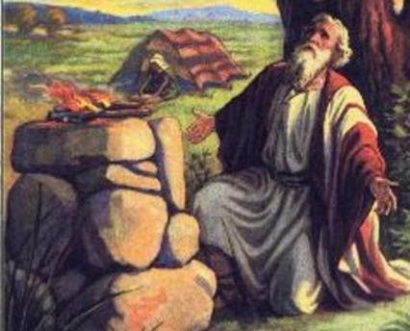
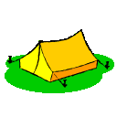
From there he went on toward the hills east of Bethel and pitched his tent, with Bethel on the west and Ai on the east. There he built an altar to the Lord and called on the name of the Lord.

Slide 10
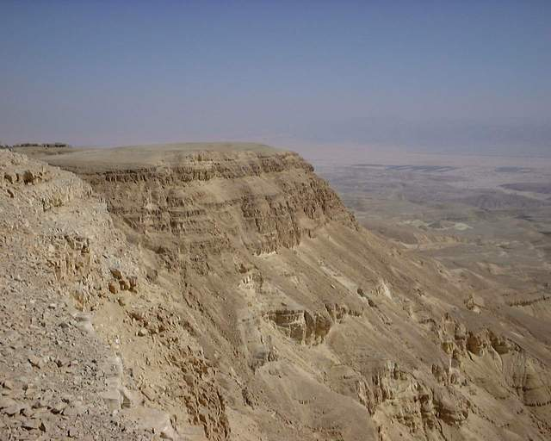
Then Abram set out and continued toward the Negev.

Slide 11
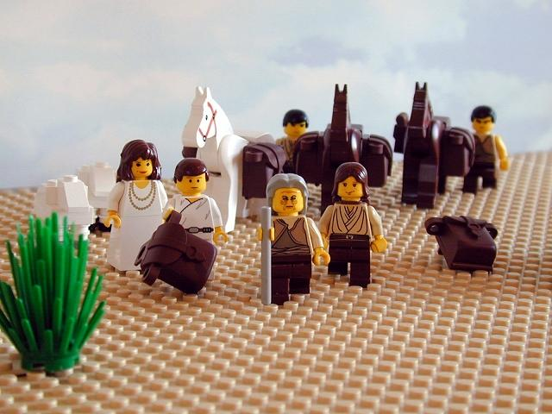
Now Lot, who was moving about with Abram

Slide 12
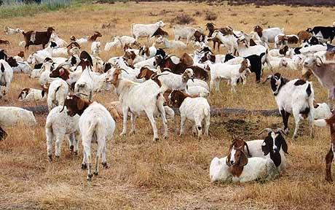
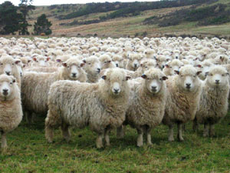
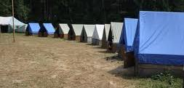
also had flocks and herds and tents.

Slide 13
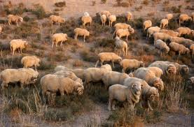
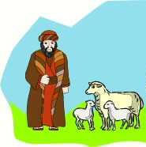
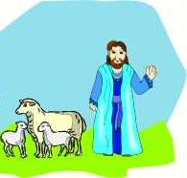
But the land could not support them while they stayed together, for their possessions were so great that they were not able to stay together.

Slide 14
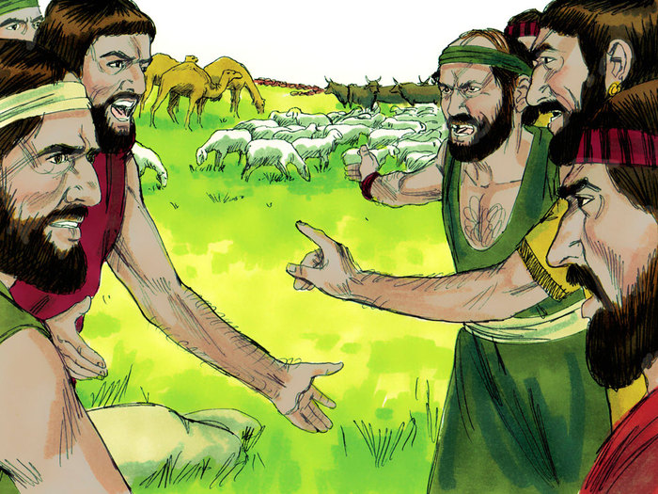
And quarreling arose between Abram’s herders and Lot’s. The Canaanites and Perizzites were also living in the land at that time.

Slide 15
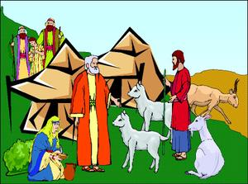
So Abram said to Lot, “Let’s not have any quarreling between you and me, or between your herders and mine, for we are close relatives.”

Slide 16
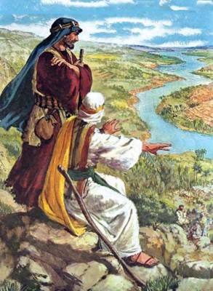
“Is not the whole land before you? Let’s part company. If you go to the left, I’ll go to the right; if you go to the right, I’ll go to the left.”

Slide 17
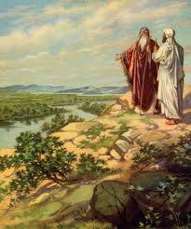
Lot looked around and saw that the whole plain of the Jordan toward Zoar was well watered, like the garden of the Lord, like the land of Egypt. (This was before the Lord destroyed Sodom and Gomorrah.)

Slide 18
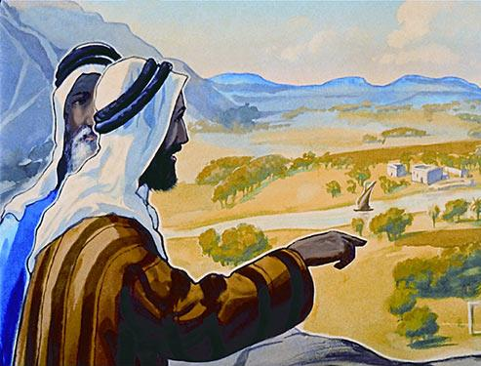
So Lot chose for himself the whole plain of the Jordan and set out toward the east. The two men parted company: Abram lived in the land of Canaan,

Slide 19
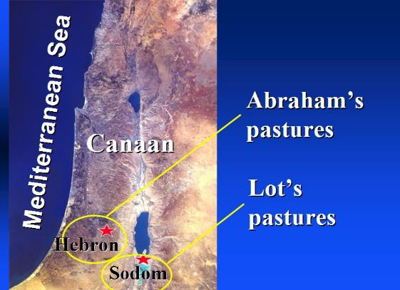
while Lot lived among the cities of the plain and pitched his tents near Sodom. Now the people of Sodom were wicked and were sinning greatly against the Lord.

Slide 20

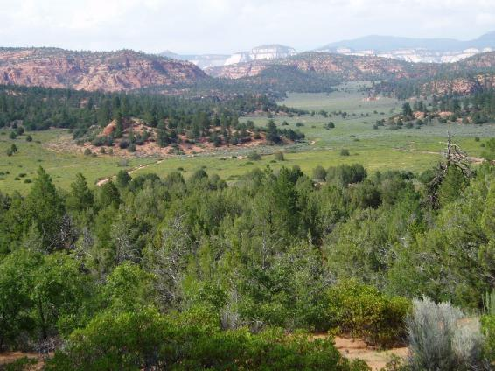
The Lord said to Abram after Lot had parted from him, “Look around from where you are, to the north and south, to the east and west. All the land that you see I will give to you and your offspring forever.

Slide 21
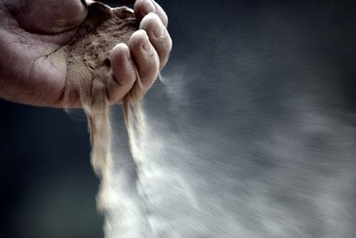
I will make your offspring like the dust of the earth, so that if anyone could count the dust, then your offspring could be counted.

Slide 22


Go, walk through the length and breadth of the land, for I am giving it to you.”

Slide 23
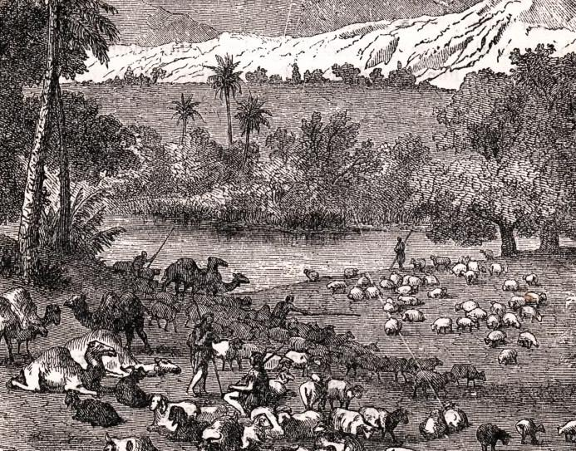
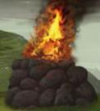
So Abram went to live near the great trees of Mamre at Hebron, where he pitched his tents. There he built an altar to the Lord.

