Slide 1
Deceived!
Dig Site 12
Genesis 27:1-41

Slide 2
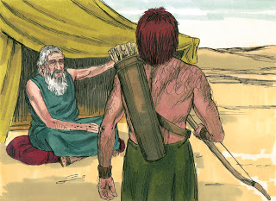
When Isaac was old and his eyes were so weak that he could no longer see, he called for Esau his older son and said to him,
My son.

Slide 3
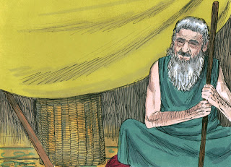
Here I am.
he answered.

Slide 4
Isaac said, I am now an old man and don’t know the day of my death.

Slide 5
Now then, get your equipment—your quiver and bow—and go out to the open country to hunt some wild game for me.

Slide 6
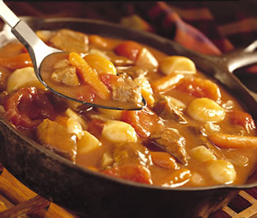
Prepare me the kind of tasty food I like and bring it to me to eat, so that I may give you my blessing before I die.

Slide 7
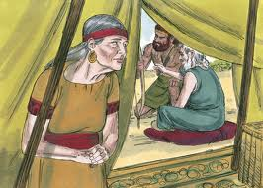
Now Rebekah was listening as Isaac spoke to his son Esau.

Slide 8
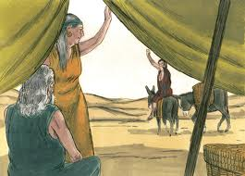
When Esau left for the open country to hunt game and bring it back, Rebekah said to her son Jacob,

Slide 9
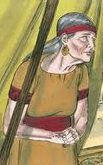
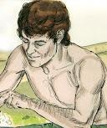
Look, I overheard your father say to your brother Esau, ‘Bring me some game and prepare me some tasty food to eat, so that I may give you my blessing in the presence of the Lord before I die.’

Slide 10
Now, my son, listen carefully and do what I tell you:

Slide 11
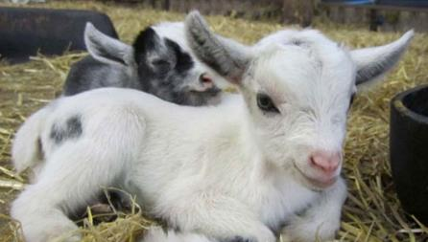
Go out to the flock and bring me two choice young goats,

Slide 12

so I can prepare some tasty food for your father, just the way he likes it.

Slide 13
Then take it to your father to eat, so that he may give you his blessing before he dies.

Slide 14
Jacob said to Rebekah his mother,
But my brother Esau is a hairy man while I have smooth skin. What if my father touches me?

Slide 15
I would appear to be tricking him and would bring down a curse on myself rather than a blessing.

Slide 16
His mother said to him,
My son, let the curse fall on me. Just do what I say; go and get them for me.

Slide 17
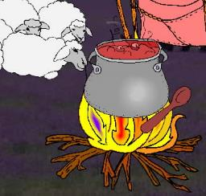
So he went and got them and brought them to his mother, and she prepared some tasty food, just the way his father liked it.
YUM!

Slide 18
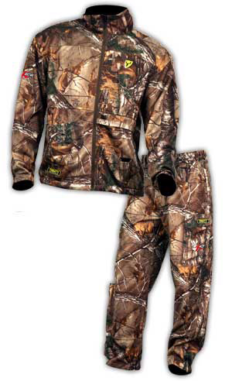
Then Rebekah took the best clothes of Esau her older son, which she had in the house, and put them on her younger son Jacob.

Slide 19
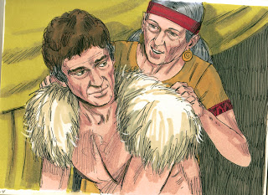
She also covered his hands and the smooth part of his neck with the goatskins.

Slide 20
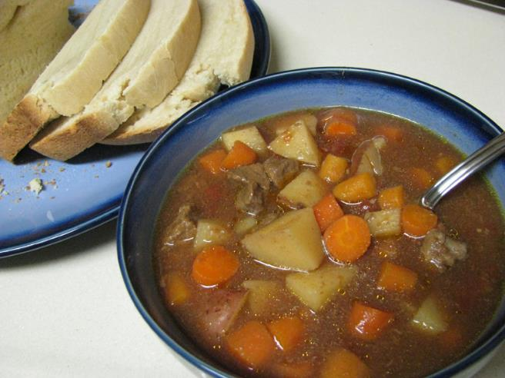
Then she handed to her son Jacob the tasty food and the bread she had made.

Slide 21
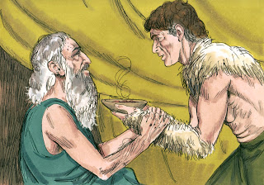
He went to his father and said,
My father.

Slide 22
“Yes, my son,” he answered. Who is it?

Slide 23
Jacob said to his father,
I am Esau your firstborn. I have done as you told me. Please sit up and eat some of my game, so that you may give me your blessing.

Slide 24
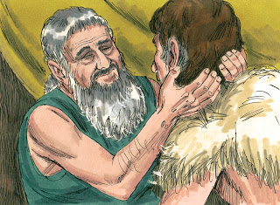
Isaac asked his son,
How did you find it so quickly, my son?

Slide 25
“The Lord your God gave me success” he replied.

Slide 26
Then Isaac said to Jacob,
Come near so I can touch you, my son, to know whether you really are my son Esau or not.

Slide 27
Jacob went close to his father Isaac, who touched him and said,
The voice is the voice of Jacob, but the hands are the hands of Esau.

Slide 28
He did not recognize him, for his hands were hairy like those of his brother Esau; so he proceeded to bless him.

Slide 29
“Are you really my son Esau?” he asked.
“I am,” he replied.

Slide 30
Then he said,
My son, bring me some of your game to eat, so that I may give you my blessing.

Slide 31
Jacob brought it to him and he ate; and he brought some wine and he drank.

Slide 32
Then his father Isaac said to him,
Come here, my son, and kiss me.
So he went to him and kissed him.

Slide 33
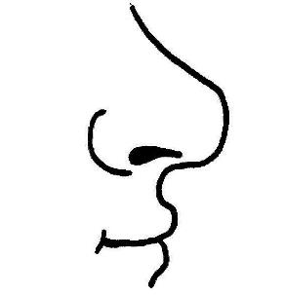

When Isaac caught the smell of his clothes, he blessed him and said, “Ah, the smell of my son is like the smell of a field that the Lord has blessed.

Slide 34

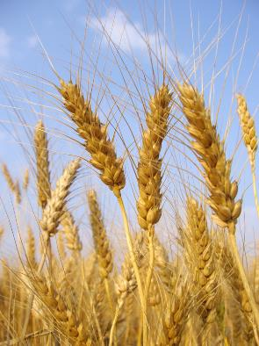

May God give you heaven’s dew and earth’s richness— an abundance of grain and new wine.

Slide 35
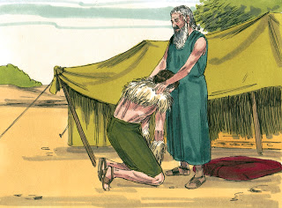
May nations serve you and peoples bow down to you.
Be lord over your brothers, and may the sons of your mother bow down to you.

Slide 36

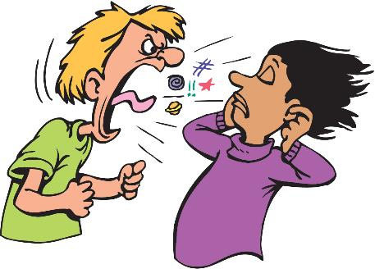
May those who curse you be cursed and those who bless you be blessed.

Slide 37
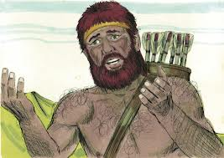
After Isaac finished blessing him, and Jacob had scarcely left his father’s presence, his brother Esau came in from hunting. He too prepared some tasty food and brought it to his father.

Slide 38

Then he said to him,
My father, please sit up and eat some of my game, so that you may give me your blessing.

Slide 39
His father Isaac asked him,
Who are you?

Slide 40
I am your son, he answered, your firstborn, Esau.

Slide 41
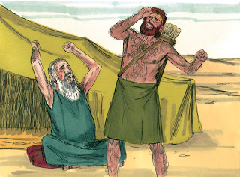
Isaac trembled violently and said,
Who was it, then, that hunted game and brought it to me?

Slide 42
I ate it just before you came and I blessed him—and indeed he will be blessed!

Slide 43
When Esau heard his father’s words, he burst out with a loud and bitter cry and said to his father,
Bless me—me too, my father!

Slide 44
But he said,
Your brother came deceitfully and took your blessing.

Slide 45
Esau said,
Isn’t he rightly named Jacob? This is the second time he has taken advantage of me:

Slide 46
He took my birthright, and now he’s taken my blessing!

Slide 47
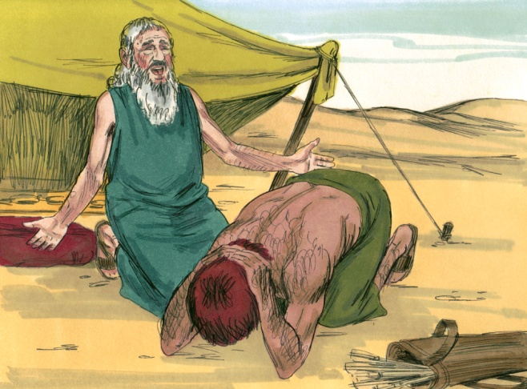
Then he asked,
Haven’t you reserved any blessing for me?

Slide 48
I have made him lord over you and have made all his relatives his servants, and I have sustained him with grain and new wine. So what can I possibly do for you, my son?
Isaac answered
Esau,

Slide 49
Esau said to his father,
Do you have only one blessing, my father? Bless me too, my father!
Then Esau wept aloud.

Slide 50

His father Isaac answered him,
“Your dwelling will be away from the earth’s richness, away from the dew of heaven above.

Slide 51
You will live by the sword and you will serve your brother.

Slide 52
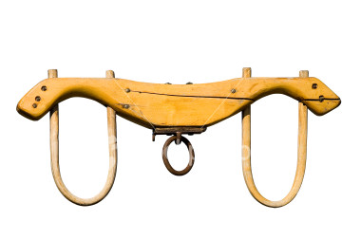
But when you grow restless, you will throw his yoke from off your neck.

Slide 53
Esau held a grudge against Jacob because of the blessing his father had given him. He said to himself,

Slide 54
The days of mourning for my father are near; then I will kill my brother Jacob.

