Slide 1
Memory Verse
Genesis 26:24b
I am the God of
your father Abraham.
Do not be afraid,
for I am with you.
Genesis 26:24b

Slide 2
Dig Site 13
Genesis 28:10-22;
29:14b-30

Slide 3
Jacob left Beersheba and set out for Harran.
B
E
E
R
S
H
E
B
A
H
A
R
R
A
N

Slide 4

When he reached a certain place, he stopped for the night because the sun had set.
Taking one of the stones there, he put it under his head and lay down to sleep.

Slide 5
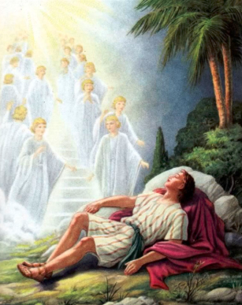
He had a dream in which he saw a stairway resting on the earth, with its top reaching to heaven, and the angels of God were ascending and descending on it.

Slide 6
There above it stood the Lord, and he said:
I am the Lord, the God of your father Abraham and the God of Isaac.
I will give you and your descendants the land on which you are lying.

Slide 7
Your descendants
will be
like the dust
of the earth,

Slide 8

and you will spread out to the west and to the east, to the north and to the south.
All peoples on earth will be blessed through you and your offspring.

Slide 9
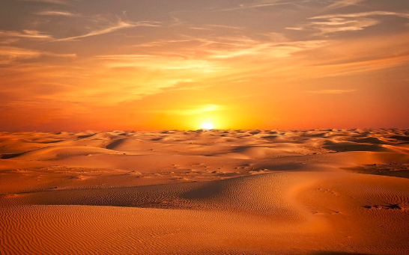
I am with you and will watch over you wherever you go, and I will bring you back to this land.
I will not leave you until I have done what I have promised you.

Slide 10
Surely the Lord is in this place, and I was not aware of it.
When Jacob awoke from his sleep,
he thought,

Slide 11
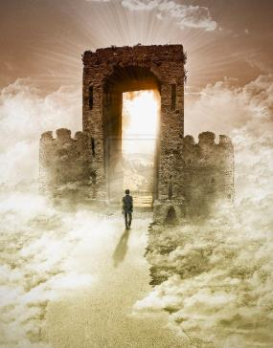
He was afraid and said,
How awesome is this place!
This is none other than the house of God;
this is the gate of heaven.

Slide 12



Early the next morning Jacob took the stone he had placed under his head and set it up as a pillar and poured oil on top of it.

Slide 13
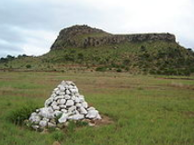
He called that place Bethel, though the city used to be called Luz.

Slide 14
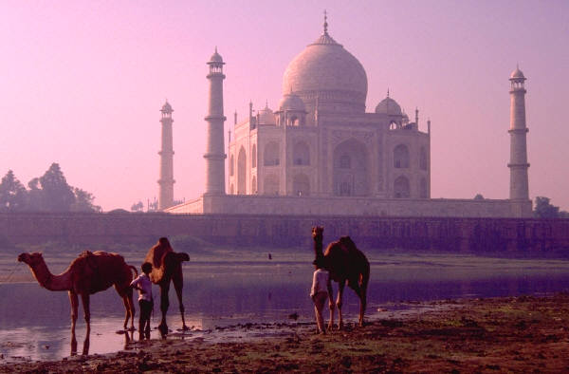

Then Jacob made a vow, saying,
If God will be with me
and will watch over me
on this journey I am taking and will give me food to eat
and clothes to wear
so that I return safely
to my father’s household, then the Lord will be my God

Slide 15
and this stone that I have set up as a pillar will be
God’s house,
and of all that you give me
I will give you a tenth.

Slide 16
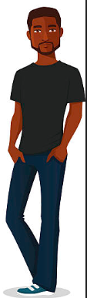
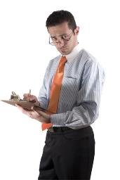
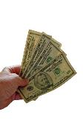
After Jacob had stayed with him for a whole month,
Laban said to him,
Just because you are a relative of mine, should you work for me for nothing?
Tell me what your wages should be.

Slide 17


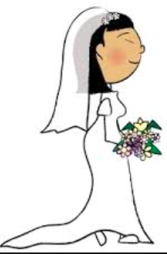
Now Laban had 2 daughters;
L
the name of the
older was Leah,
and the name of
the younger
was Rachel.
R

Slide 18
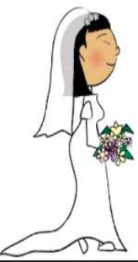
but Rachel had a lovely figure and was beautiful.
Leah had weak eyes,

Slide 19
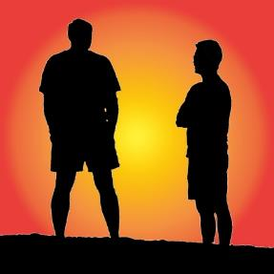

Jacob was in love with
Rachel and said,
I’ll work for you 7 years in return for your younger daughter Rachel.

Slide 20


Laban said,
It’s better that I give her to you
than to some other man.
Stay here with me.

Slide 21

So Jacob served
7 years to get Rachel, but they seemed like only a few days to him because of his love for her.

Slide 22

Then Jacob said to Laban,
Give me my wife.
My time is completed,
and I want to make love to her.

Slide 23
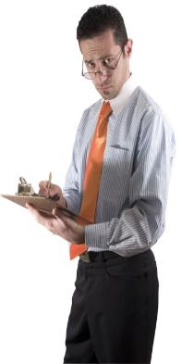
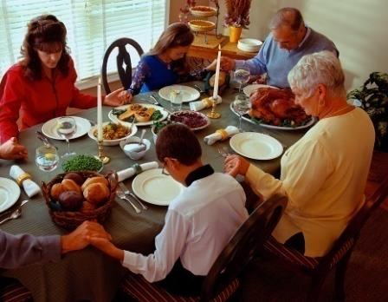
So Laban brought together all the people of the place and gave a feast.

Slide 24
But when evening came, he took his daughter Leah and brought her to Jacob, and Jacob made love to her.

Slide 25

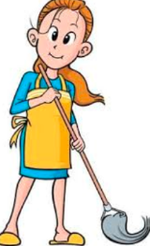
And Laban gave his servant Zilpah to his daughter as her attendant.

Slide 26


When morning came, there was Leah! So Jacob said to Laban,
What is this you have done to me?
I served you for Rachel, didn’t I?
Why have you deceived me?

Slide 27

Laban replied,
It is not our custom here to give the younger daughter in marriage before the older one.

Slide 28
Finish this daughter’s bridal week; then we will give you the younger one also, in return for another
7 years of work.

Slide 29

And Jacob did so.
He finished the week with Leah, and then Laban gave him his daughter Rachel to be his wife.

Slide 30



Laban gave his servant Bilhah to his daughter Rachel as her attendant.

Slide 31
Jacob made love to Rachel also, and his love for Rachel was greater than his love for Leah.
And he worked for Laban another 7 years.

