Slide 1
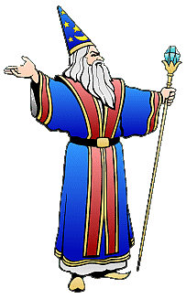
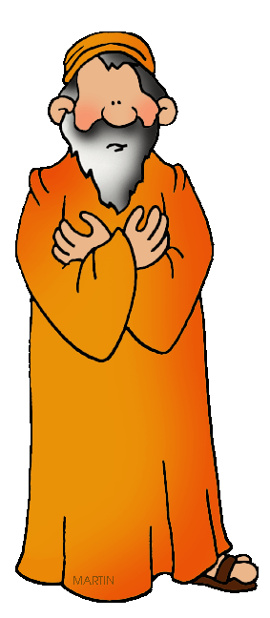
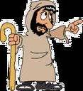
Exodus Dig Site #6
Staffs, Snakes & Magicians
Exodus 6:28 – 7:24

Slide 2
Memory Verse
The earth is the Lord’s and everything in it, the world, and all who live in it.
Psalm 24:1
#6

Slide 3

Aaron to Speak for Moses

Slide 4
But Moses said to the LORD,
Now when the LORD spoke to Moses in Egypt, he said to him,
I am the LORD.
Tell Pharaoh king of Egypt everything I tell you.
Since I speak with faltering lips, why would Pharaoh listen to me?

Slide 5

Then the LORD said to Moses,
"See, I have made you like God to Pharaoh, and your brother Aaron will be your prophet.

Slide 6
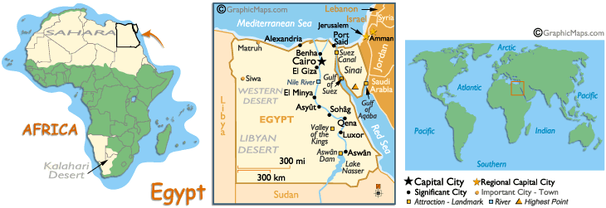
You are to say everything I command you, and your brother Aaron is to tell Pharaoh to let the Israelites go out of his country.

Slide 7

But I will harden Pharaoh's heart, and though I multiply my signs and wonders in Egypt, he will not listen to you.

Slide 8
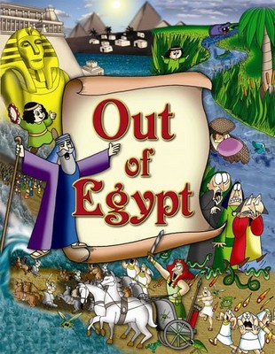
Then I will lay my hand on Egypt and with mighty acts of judgment I will bring out my divisions, my people the Israelites.
And the Egyptians
will know that I am
the LORD
when I stretch out
my hand
against Egypt and
bring the Israelites
out of it.

Slide 9
Moses and Aaron did just as the LORD commanded them.
Moses was 80 years old and Aaron 83 when they spoke to Pharaoh.

Slide 10
The LORD said to Moses and Aaron,
"When Pharaoh says to you,
'Perform a miracle,' then say to Aaron,
'Take your staff and throw it down before Pharaoh,' and it will become a snake.”

Slide 11
So Moses and Aaron went to Pharaoh and did just as the LORD commanded.
Aaron threw his staff down in front of Pharaoh and his officials, and it became a snake.

Slide 12
Pharaoh then summoned wise men and sorcerers, and the Egyptian magicians also did the same things by their secret arts:
Each one threw down his staff and it became a snake.

Slide 13

But Aaron's staff swallowed up their staffs.
Yet Pharaoh's heart became hard
and he would not listen to them,
just as the LORD had said.

Slide 14
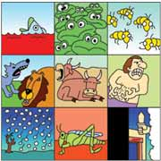
The Plague of Blood

Slide 15
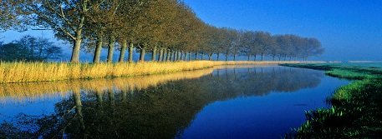
Then the LORD said to Moses,
"Pharaoh's heart is unyielding; he refuses to let the people go.
Go to Pharaoh in the morning as he goes out to the river. Confront him on the bank of the Nile, and take in your hand the staff that was changed into a snake.
Then say to him, 'The LORD, the God of the Hebrews, has sent me to say to you:
Let my people go, so that they may worship me in the wilderness.
But until now you have not listened.

Slide 16

This is what the LORD says:
By this you will know that I am the LORD: With the staff that is in my hand I will strike the water of the Nile, and it will be changed into blood.
The fish in the Nile will die, and the river will stink; the Egyptians will not be able to drink its water.'

Slide 17
The LORD said to Moses,
"Tell Aaron,
'Take your staff and stretch out your
hand over the waters of Egypt —
over the streams and canals,
over the ponds and all the reservoirs - and they will turn to blood.

Slide 18
Blood will be everywhere in Egypt, even in vessels of wood and stone.

Slide 19
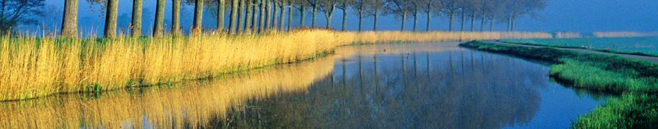
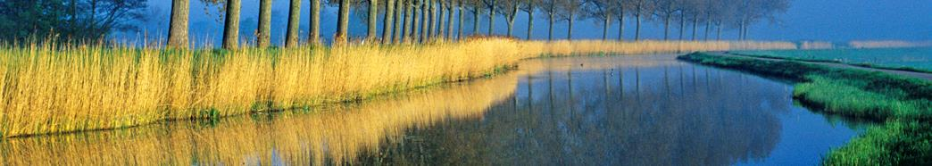
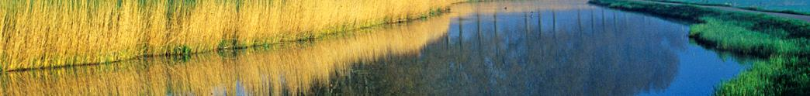
Moses and Aaron did just as the LORD had commanded. He raised his staff in the presence of Pharaoh and his officials and struck the water of the Nile, and all the water was changed into blood.

Slide 20
The fish in the Nile died, and the river smelled so bad that the Egyptians could not drink its water.
Blood was everywhere in Egypt.

Slide 21

But the Egyptian magicians did the
same things by their secret arts,
and Pharaoh's heart became hard;
he would not listen
to Moses and Aaron,
just as the LORD
had said.

Slide 22

Instead, he turned and went into his palace, and did not take
even this to heart.
And all the Egyptians dug along the Nile to get drinking water, because they could not drink the water of the river.

