Slide 1
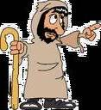
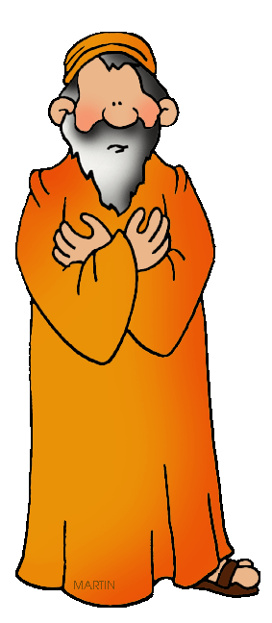
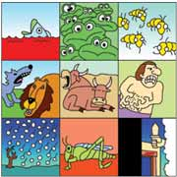
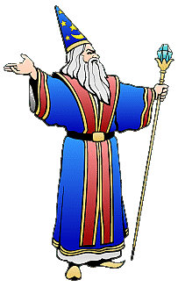
Dig Site 8
Exodus 9:1-35
Plagues of
Livestock (5)
Boils (6)
Hail (7)

Slide 2
Memory Verse
A person may think their own ways are right,
but the Lord weighs
the heart.
Proverbs 21:2

Slide 3
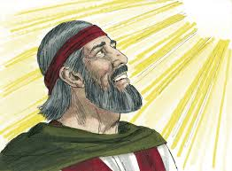
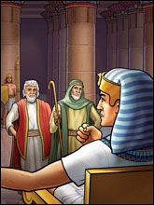
Then the LORD said to Moses,
Go to Pharaoh and say to him,
“This is what the LORD, the God of the Hebrews, says: Let my people go,
so that they may worship me."

Slide 4
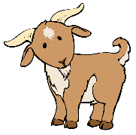

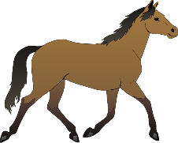
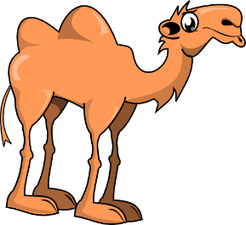


If you refuse to let them go and
continue to hold them back,
the hand of the LORD will bring a terrible plague on your livestock in the field—on your horses, donkeys and camels and on your cattle and sheep and goats.

Slide 5












But the LORD will make a distinction between the livestock of Israel and that of Egypt, so that no animal belonging to the Israelites will die.
Egyptian
Israelite

Slide 6
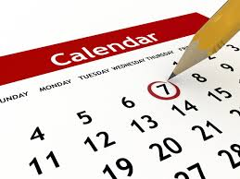
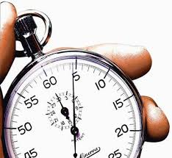
The LORD set a time and said, Tomorrow the LORD will do
this in the land.

Slide 7
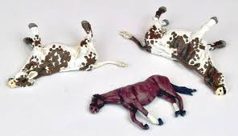
And the next day the LORD did it: All the livestock of the Egyptians died, but not one animal belonging to the Israelites died.
Pharaoh investigated and found that not even one of the animals of the Israelites had died.
Egyptian
Israelite

Slide 8

Yet his heart was unyielding and he would not let the people go.

Slide 9
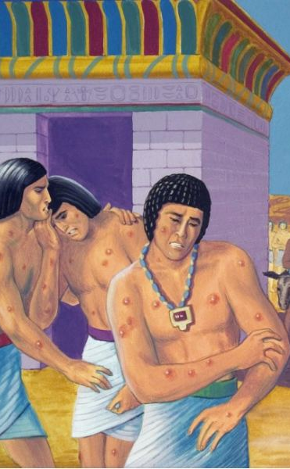
The Plague of Boils

Slide 10
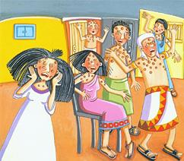
Then the LORD said to Moses and Aaron,
Take handfuls of soot from a furnace and have Moses toss it into the air in the presence of Pharaoh.
It will become fine dust over the whole land of Egypt, and festering boils will break out on men and animals throughout the land.

Slide 11
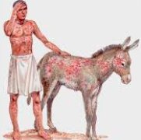
So they took soot from a furnace and stood before Pharaoh. Moses tossed it into the air, and festering boils broke out on people and animals.
The magicians could not stand before Moses because of the boils that were on them and on all the Egyptians.

Slide 12
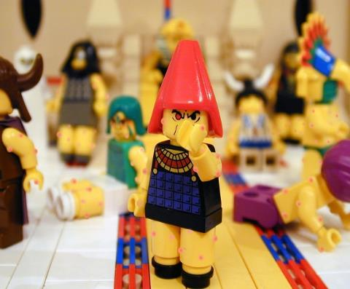

But the Lord hardened Pharaoh's heart,
and he would not listen to
Moses and Aaron,
just as the Lord had said to Moses.

Slide 13
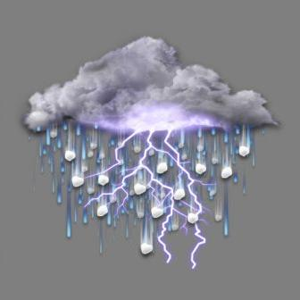
The Plague of Hail

Slide 14

Then the LORD said to Moses,
Get up early in the morning,
confront Pharaoh and say to him,
“This is what the LORD,
the God of the Hebrews, says:
Let my people go, so that they may worship me, or this time I will send the full force of my plagues against you and against your officials and your people,
so you may know that there is no one like me in all the earth.”

Slide 15
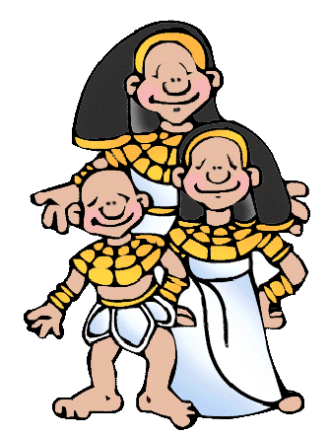
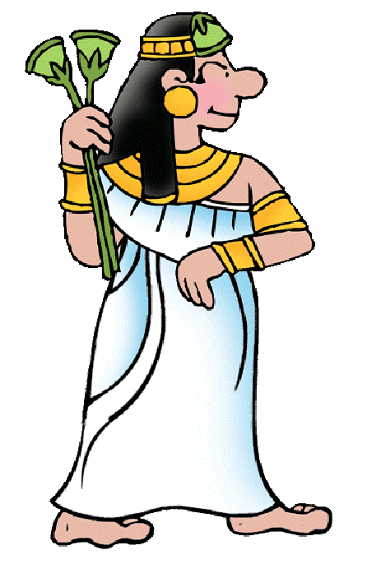
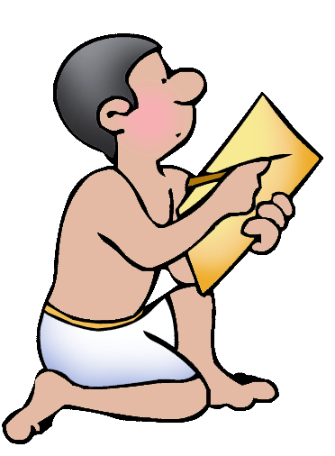
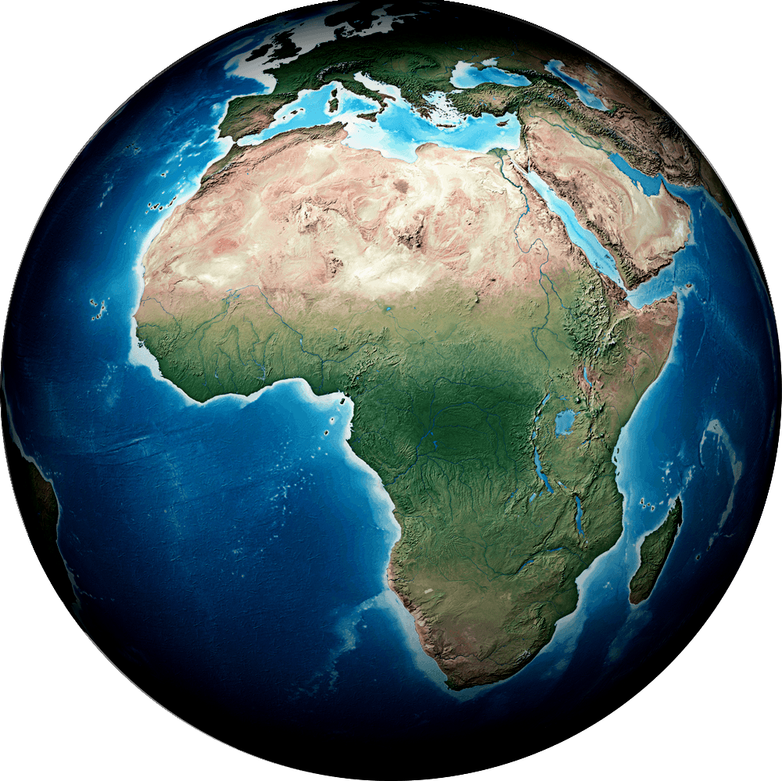
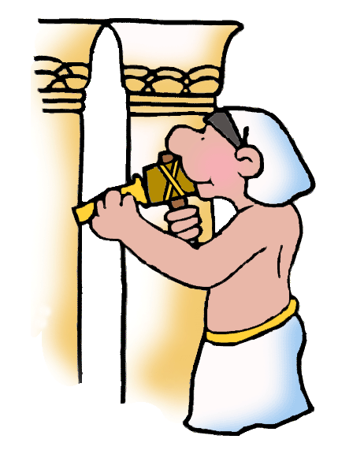
For by now I could have stretched out my hand and struck you and your people with a plague that would have wiped you off the earth.

Slide 16
But I have raised you up for this very purpose, that I might show you my power and that my name might be proclaimed in all the earth.
You still set yourself against my people and will not let them go.

Slide 17
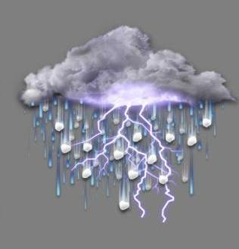
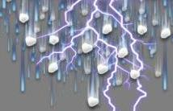
Therefore, at this time tomorrow
I will send the worst hailstorm that has ever fallen
on Egypt,
from the day it was founded till now.

Slide 18






Give an order now to bring your livestock
and everything you have in the field to a place of shelter,
because the hail will fall on every person and animal that has not
been brought in and is still out in
the field,
and they will die.

Slide 19
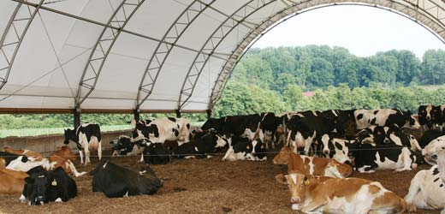
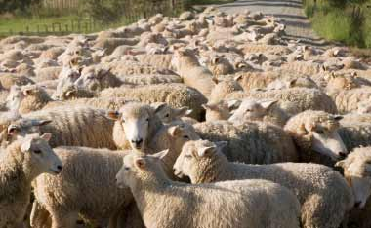
Those officials of Pharaoh who feared the word of the LORD hurried to bring their slaves and their livestock inside.
But those who ignored the word of the LORD left their slaves and livestock
in the field.

Slide 20
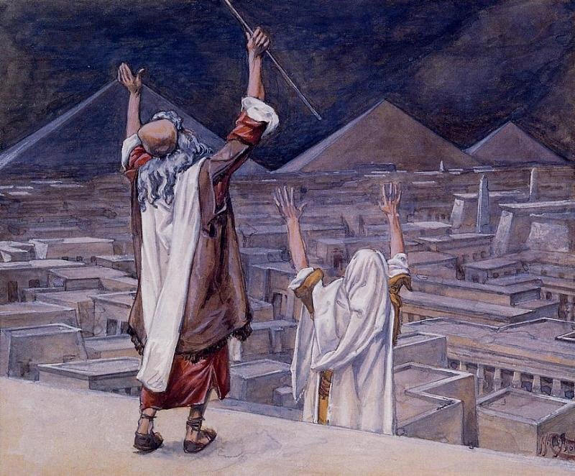
Then the LORD
said to Moses,
Stretch out your hand toward the sky so that hail will fall all over Egypt—on people and animals
and on everything growing in the fields of Egypt.

Slide 21
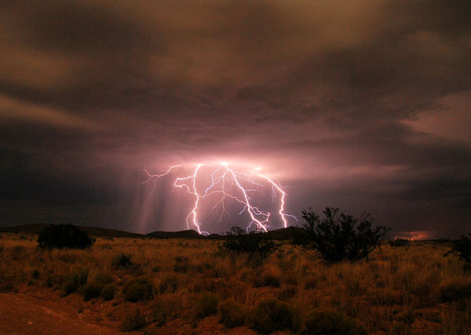

When Moses stretched out his staff toward the sky,
the Lord sent thunder and hail,
and lightning flashed down
to the ground.

Slide 22
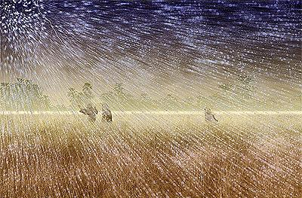
So the LORD rained hail on the land of Egypt; hail fell and lightning flashed back and forth. It was the worst storm in all the land of Egypt since it had become a nation.

Slide 23
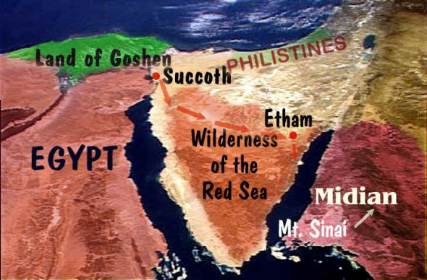
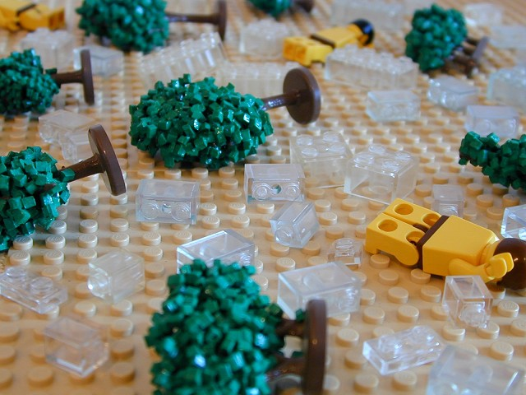
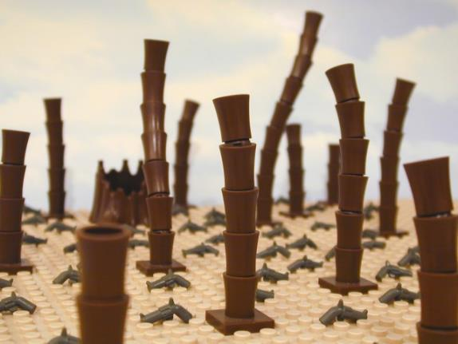
Throughout Egypt hail struck everything in the fields—both people and animals;
it beat down everything growing in the fields and stripped every tree.
The only place it did not hail was the land of Goshen, where the Israelites were.

Slide 24
Then Pharaoh summoned Moses and Aaron.
This time I have sinned,
he said to them.
"The LORD is in the right, and I and my people are
in the wrong.
Pray to the LORD,
for we have had enough thunder and hail.
I will let you go; you don't have to stay any longer."

Slide 25


Moses replied,
When I have gone out of the
city, I will spread out my hands in prayer to the LORD. The thunder will stop and
there will be no more
hail, so you may know
that the earth is the
LORD's.
But I know that you
and your officials still
do not fear
the LORD God.

Slide 26

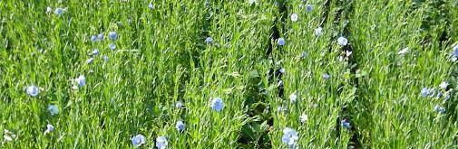
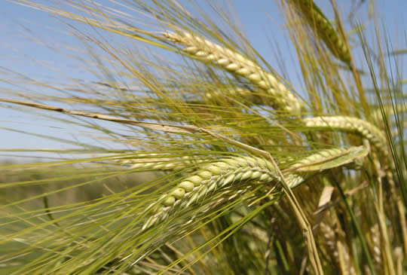
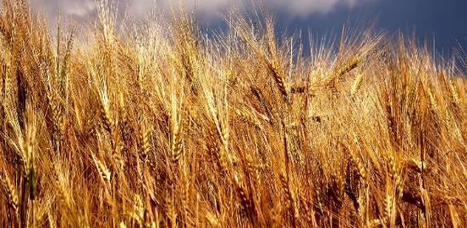
(The flax and barley were destroyed, since the barley had headed and
the flax was in bloom.
The wheat and spelt, however, were not destroyed, because they ripen later.)

Slide 27
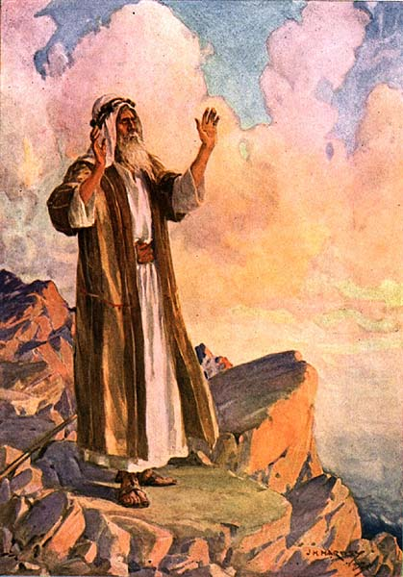
Then Moses left Pharaoh and went out of
the city.
He spread out his hands toward the Lord;
the thunder and hail stopped and the rain no longer poured down on
the land.

Slide 28
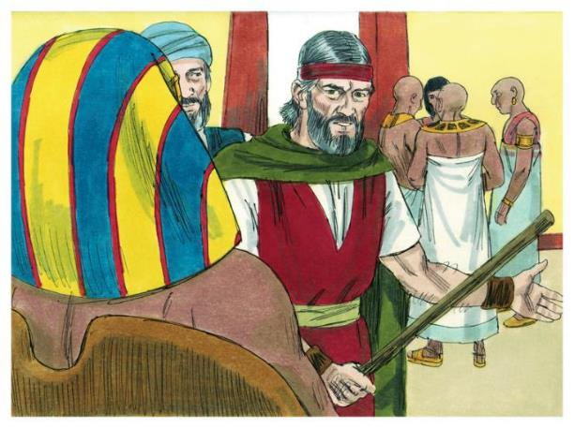
When Pharaoh saw that the rain and hail and thunder had stopped, he sinned again: He and his officials hardened their hearts.

Slide 29
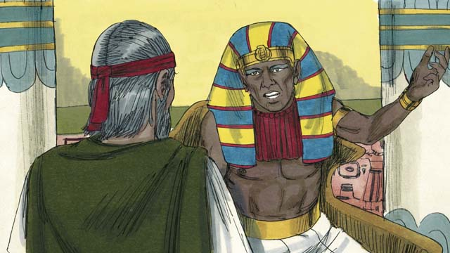
So Pharaoh's heart was hard and
he would not let the Israelites go,
just as the LORD had said
through Moses.

