Slide 1
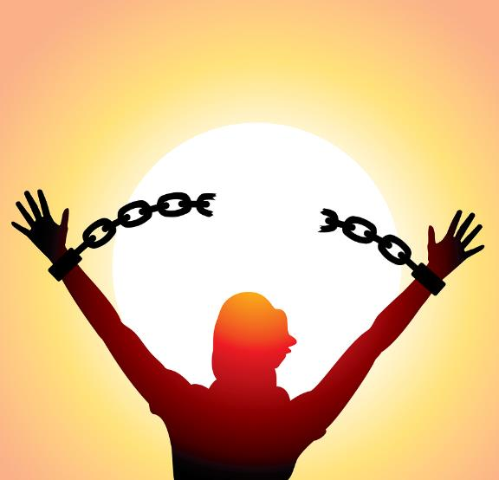
Exodus 12:1 - 42 Dig Site 10
Free at Last!

Slide 2
Memory Verse
The Lord is my strength
and my defense;
he has become my salvation.
He is my God,
and I will praise him,
my father’s God,
and I will exalt him.
Exodus 15:2

Slide 3
The Passover and the
Festival of Unleavened Bread

Slide 4
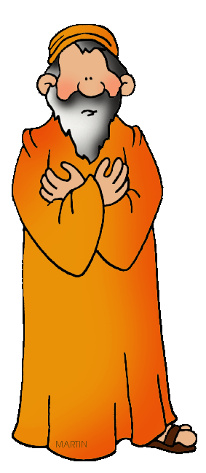
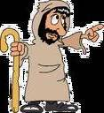

The Lord said to Moses and Aaron in Egypt,
This month is to be for you the 1st month,
the 1st month of your year.
1st month,
1st month of your year.

Slide 5
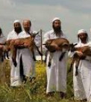
1st month,
1st month of your year.
Tell the whole community of Israel that on the 10th day of this month each man is to take a lamb for his family,
1 for each household.

Slide 6

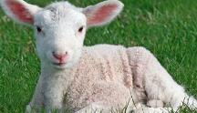
If any household is too small for a whole lamb, they must share 1 with their nearest neighbor, having taken into account the number of people there are. You are to determine the amount of lamb needed in accordance with what each person will eat.

Slide 7
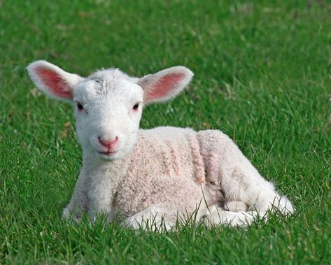
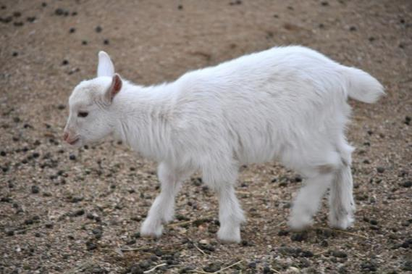
The animals you choose must be year-old males without defect,
and you may take them from the sheep or the goats.

Slide 8

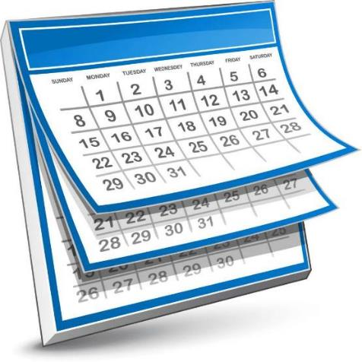
Take care of them until the 14th day of the month, when all the members of the community of Israel must slaughter them at twilight.

Slide 9
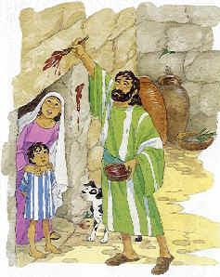
Then they are to take some of the blood and put it on the sides and tops of the doorframes of the houses where they eat the lambs.

Slide 10
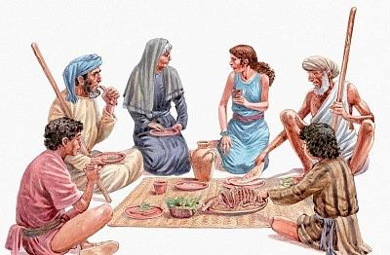
That same night they are to eat the meat roasted over the fire,
along with bitter herbs,
and bread made without yeast.

Slide 11
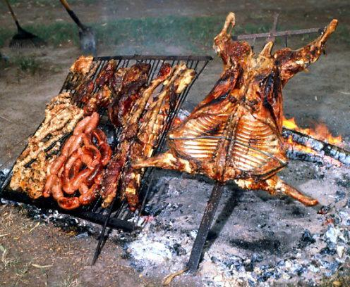
Do not eat the meat raw or boiled in water, but roast it over a fire—with the head, legs and internal organs.
Do not leave any of it till morning;
if some is left till morning,
you must burn it.

Slide 12
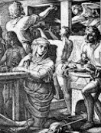
This is how you are to eat it: with your cloak tucked into your belt, your sandals on your feet and your staff in your hand. Eat it in haste; it is the Lord’s Passover.

Slide 13
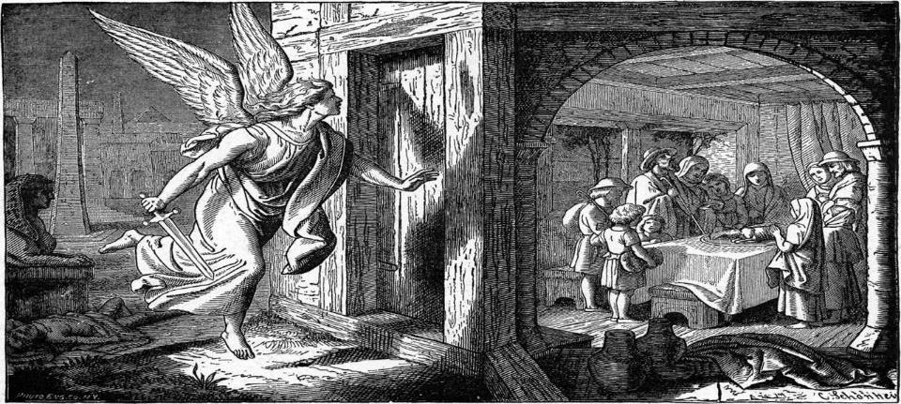
On that same night I will pass through Egypt and strike down every 1st born of both people and animals,
and I will bring judgment on all the gods of Egypt. I am the Lord.

Slide 14
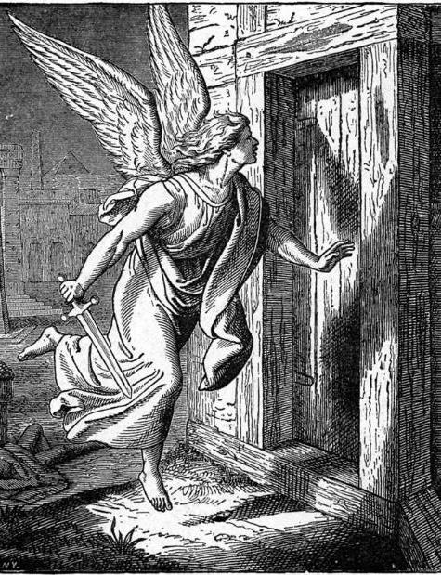
The blood will be a sign for you on the houses where you are, and when I see the blood, I will pass over you. No destructive plague will touch you when I strike Egypt.

Slide 15
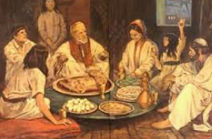
This is a day you are to commemorate;
for the generations to come you shall celebrate it as a festival to the Lord—a lasting ordinance.

Slide 16

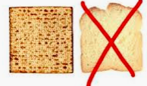
For 7 days you are to eat bread made without yeast.
On the 1st day remove the yeast from your houses,
for whoever eats anything with yeast in it from the
1st day through the 7th
must be cut off from Israel.
7days

Slide 17
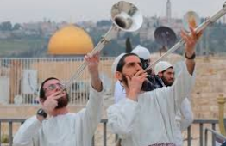
On the 1st day hold a sacred assembly, and another one on the 7th day. Do no work at all on these days, except to prepare food for everyone to eat;
that is all you may do.
Days 1&7
work

Slide 18
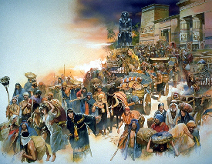
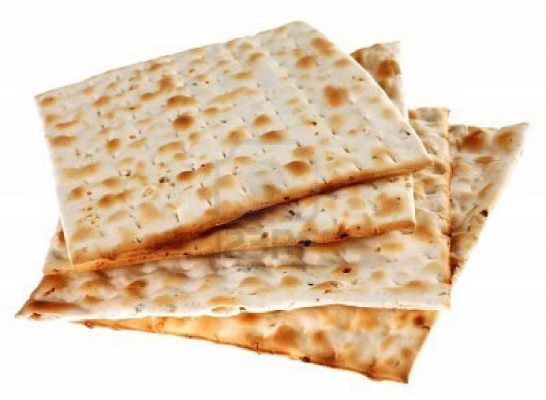
Celebrate the Festival of Unleavened Bread, because it was on this very day that I brought your divisions out of Egypt.
Celebrate this day as a lasting ordinance for the generations to come.

Slide 19
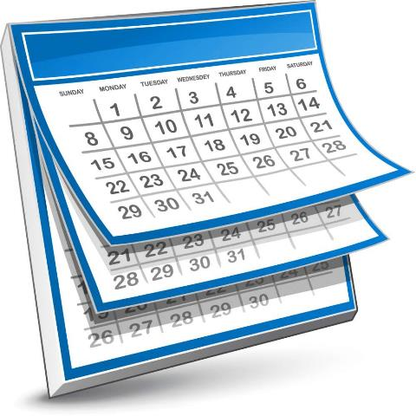

In the 1st month you are to eat bread made without yeast,
from the evening of the 14th day until the evening of the 21st day.

Slide 20
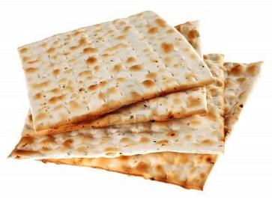
For 7 days no yeast is to be found in your houses. And anyone, whether foreigner or native-born, who eats anything with yeast in it must be cut off from the community of Israel. Eat nothing made with yeast. Wherever you live, you must eat unleavened bread.

Slide 21
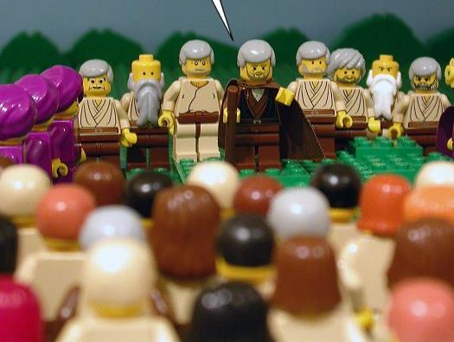
Then Moses summoned all the elders of Israel and said to them,
Go at once and select the animals for your families and slaughter the Passover lamb.

Slide 22
Take a bunch of hyssop, dip it into the blood in the basin and put some of the blood on the top and on both sides of the doorframe. None of you shall go out of the door of your house until morning.

Slide 23
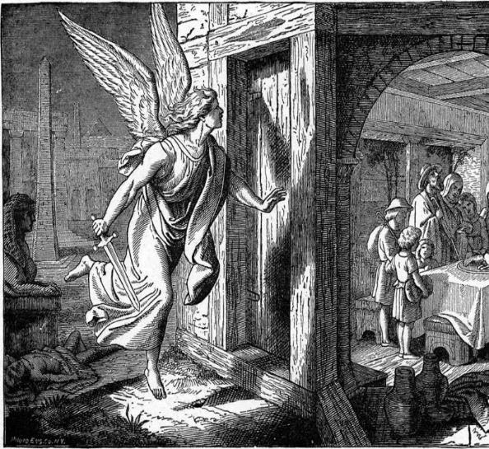
When the Lord goes through the land to strike down the Egyptians,
he will see the blood on the top and sides of the doorframe
and will pass over that doorway, and he will not permit the destroyer to enter your houses and strike you down.

Slide 24
Obey these instructions as a lasting ordinance for you and your descendants.
When you enter the land that the Lord will give you as he promised, observe this ceremony.

Slide 25
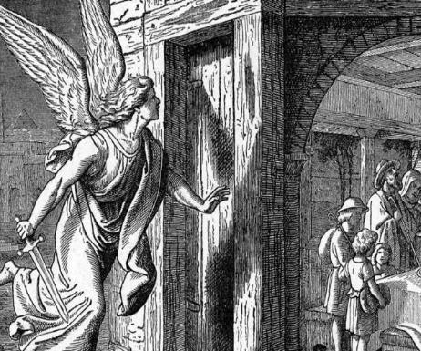
And when your children ask you,
What does this ceremony mean to you?
then tell them
It is the Passover sacrifice to the Lord, who passed over the houses of the Israelites in Egypt and spared our homes when he struck down the Egyptians.

Slide 26
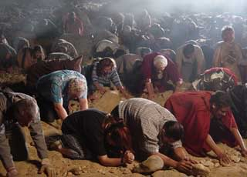
Then the people bowed down and worshiped. The Israelites did just what the Lord commanded Moses and Aaron.

Slide 27
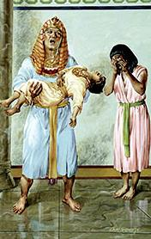
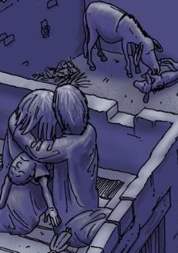

At midnight the Lord struck down all the 1st born in Egypt, from the 1st born of Pharaoh, who sat on the throne, to the 1st born of the prisoner, who was in the dungeon, and the 1st born of all the livestock as well.

Slide 28
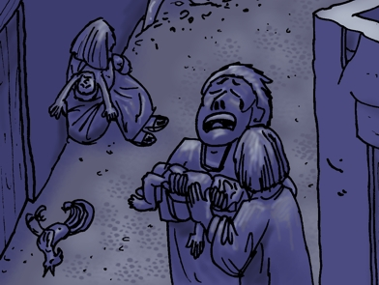
Pharaoh and all his officials and all the Egyptians got up during the night, and there was loud wailing in Egypt, for there was not a house without someone dead.

Slide 29
The Exodus

Slide 30
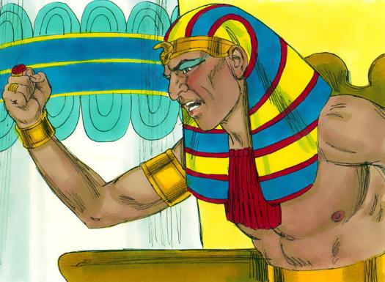
During the night Pharaoh summoned Moses and Aaron and said,
Up! Leave my people, you and the Israelites! Go, worship the Lord as you have requested.
Take your flocks and herds, as you have said, and go. And also bless me.

Slide 31
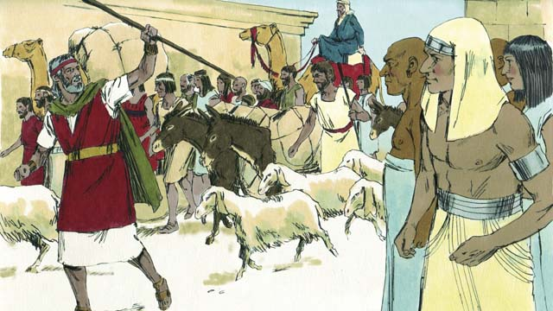
The Egyptians urged the people to hurry and leave the country. “For otherwise,” they said, “we will all die!”

Slide 32

So the people took
their dough before
the yeast was added,
and carried it on
their shoulders
in kneading troughs
wrapped in clothing.

Slide 33
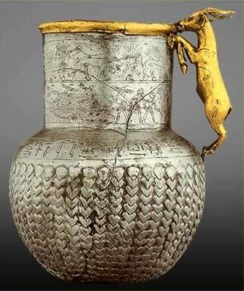

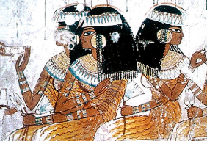

The Israelites did as Moses instructed and asked the Egyptians for articles of silver and gold and for clothing.

Slide 34
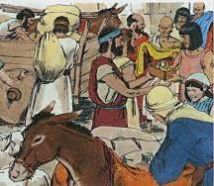
The Lord had made the Egyptians favorably disposed toward the people, and they gave them what they asked for; so they plundered the Egyptians.

Slide 35
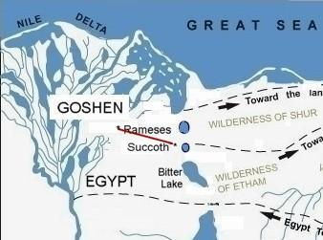
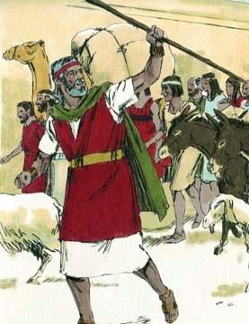
The Israelites journeyed from Rameses to Sukkoth. There were about 600,000 men on foot, besides women and children.
Many other people went up with them, and also large droves of livestock, both flocks and herds.

Slide 36
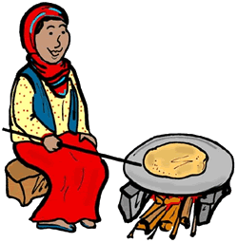
With the dough the Israelites had brought . from Egypt, they baked loaves of unleavened bread.
The dough was without yeast because they had been driven out of Egypt and did not have time to prepare food for themselves.

Slide 37
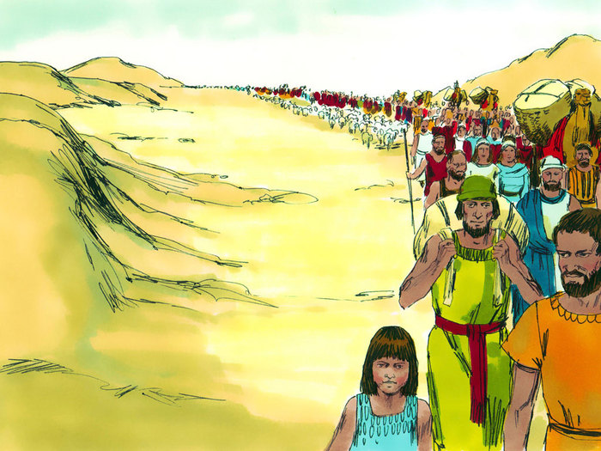
Now the length of time the Israelite people lived in Egypt was 430 years. At the end of the 430 years, to the very day, all the Lord’s divisions left Egypt.

Slide 38
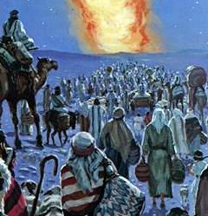
Because the Lord kept vigil that night
to bring them out of Egypt,
on this night all the Israelites are to keep vigil to honor the Lord for the generations to come.

