Slide 1
Haters gonna hate!
Exodus 16:1-31,17:1-7

Slide 2
Memory Verse
Who among the gods is like you, LORD?
Who is like you—
majestic in holiness,
awesome in glory,
working wonders?
Exodus 15:11
Lesson #12

Slide 3
The whole Israelite community set out from Elim and came to the Desert of Sin, which is between Elim and Sinai, on the 15th day of the 2nd month after they had come out of Egypt.
ELIM
SIN

Slide 4
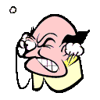

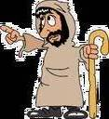
In the desert the whole community grumbled against Moses and Aaron.

Slide 5
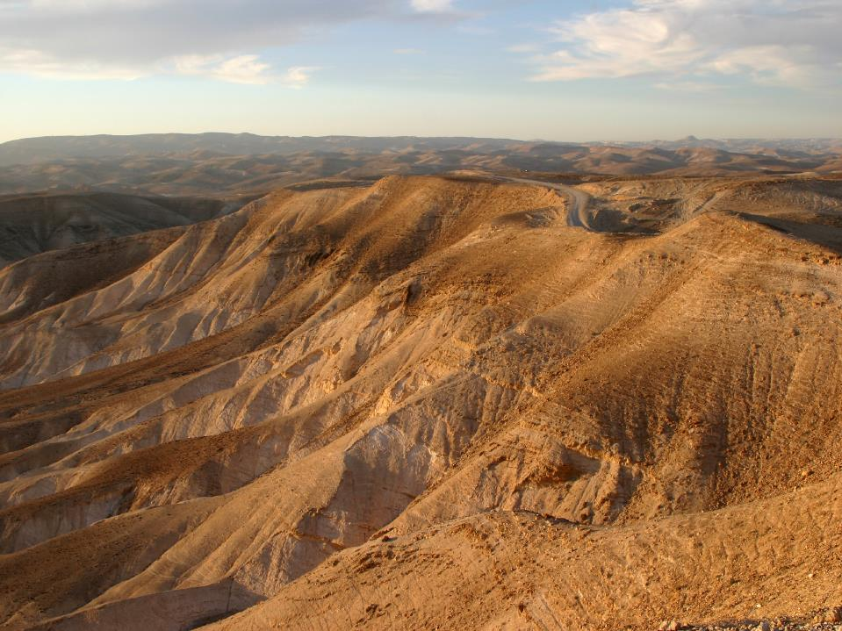
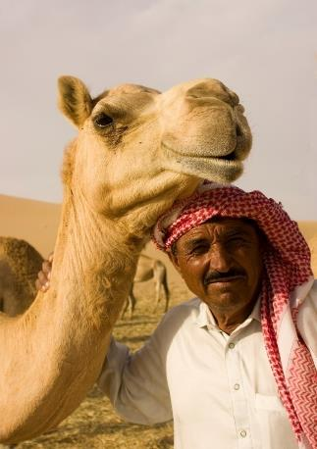
The Israelites said to them,
If only we had died by the LORD's hand in Egypt!

Slide 6
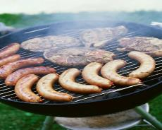
There we sat around pots of meat and ate all the food we wanted…

Slide 7
…but you have brought us out into this desert to starve this entire assembly to death.

Slide 8
Then the LORD said to Moses, "I will rain down bread from heaven for you.

Slide 9
The people are to go out each day and gather enough for that day.

Slide 10

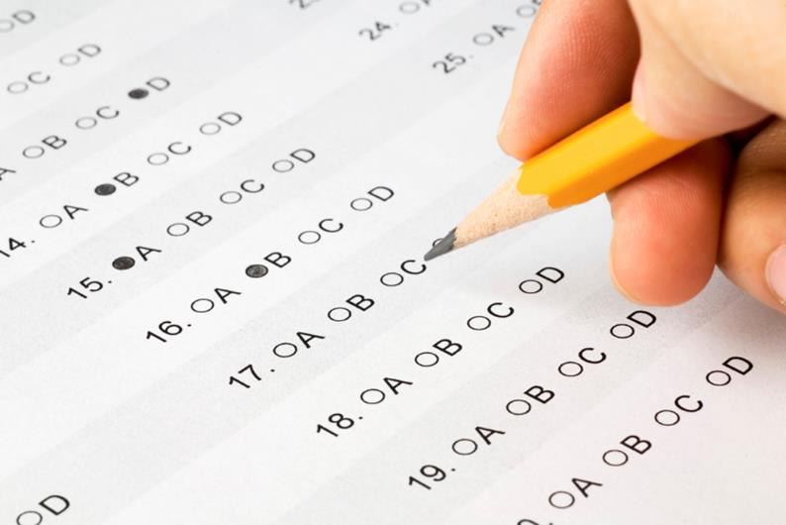
In this way I will test them and see whether they will follow my instructions.

Slide 11
On the 6th day they are to prepare what they bring in, and that is to be twice as much as they gather on the other days."
1st 2nd 3rd 4th 5th 6th

Slide 12
So Moses and Aaron said to all the Israelites,
In the evening you will know that it was the LORD who brought you out of Egypt, and in the morning you will see the glory of the LORD, because he has heard your grumbling against him. Who are we, that you should grumble against us?

Slide 13
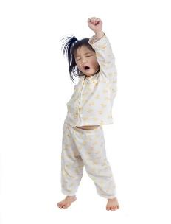
Moses also said,
You will know that it was the LORD when he gives you meat to eat in the evening and all the bread you want in the morning, because he has heard your grumbling against him.

Slide 14
Who are we? You are not grumbling against us, but against the LORD.

Slide 15
Then Moses told Aaron,
Say to the entire Israelite community,
'Come before the LORD, for he has heard your grumbling.'

Slide 16
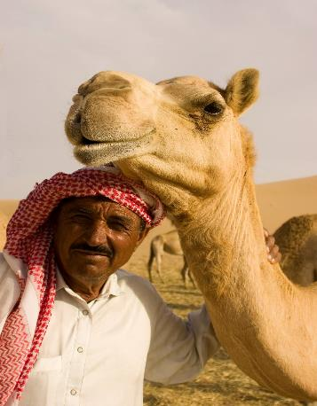
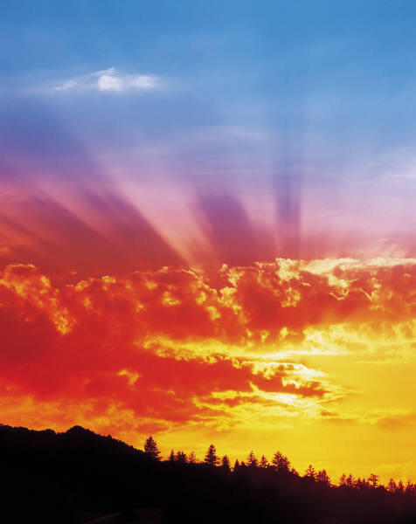
While Aaron was speaking to the whole Israelite community, they looked toward the desert, and there was the glory of the LORD appearing in the cloud.

Slide 17
The LORD said to Moses, “I have heard the grumbling of the Israelites. Tell them, ‘At twilight you will eat meat, and in the morning you will be filled with bread.
Then you will know that I am the LORD your God.’”

Slide 18
That evening quail came and covered the camp,

Slide 19


and in the morning there was a layer of dew around the camp.

Slide 20

When the dew was gone,
thin flakes like frost on the ground appeared on the desert floor.

Slide 21
When the Israelites saw it, they said to each other,
What is it?
What is it?
For they did not know what it was.

Slide 22
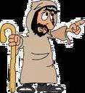
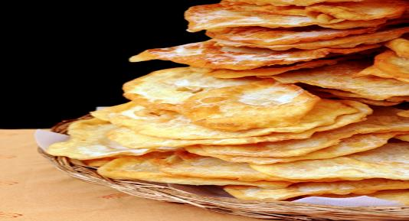
Moses said to them,
It is the bread the LORD has given you to eat.

Slide 23

This is what the LORD has commanded: 'Everyone is to gather as much as they need. Take an omer for each person you have in your tent.'

Slide 24

The Israelites did as they were told; some gathered much, some little. And when they measured it by the omer, the one who gathered much did not have too much, and the one who gathered little did not have too little.

Slide 25
Everyone had gathered just as much
as they needed.
Then Moses said to them,
No one is to keep any of it until morning.

Slide 26
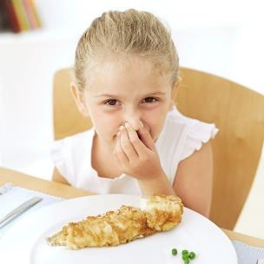
However, some of them paid no attention to Moses; they kept part of it until morning, but it was full of maggots and began to smell.
So Moses was angry with them.

Slide 27
Each morning everyone gathered as much as they needed, and when the sun grew hot, it melted away.

Slide 28
On the 6th day, they gathered twice as much— 2 omers for each person—
and the leaders of the community came and reported this to Moses.

Slide 29
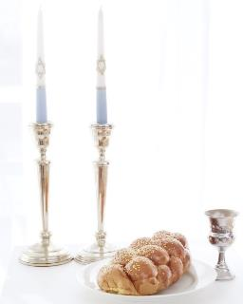
He said to them,
This is what the LORD commanded:
'Tomorrow is to be a day of Sabbath rest, a holy Sabbath to the LORD. So bake what you want to bake and boil what you want to boil. Save whatever is left and keep it until morning.'

Slide 30

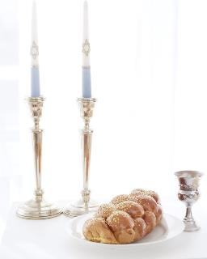
So they saved it until morning,
as Moses commanded,
and it did not stink or get maggots in it.
“Eat it today,” Moses said, “because today is a Sabbath to the LORD.

Slide 31
You will not find any of it on the
ground today.
Six days you are to gather it,
but on the 7th day, the Sabbath,
there will not be any.”

Slide 32

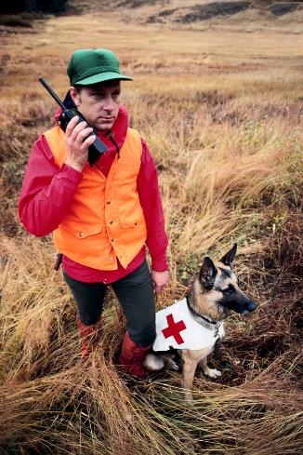
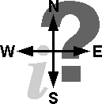
Nevertheless, some of the people went out on the 7th day to gather it, but they found none.

Slide 33
Then the LORD said to Moses, "How long will you refuse to keep my commands and my instructions?

Slide 34
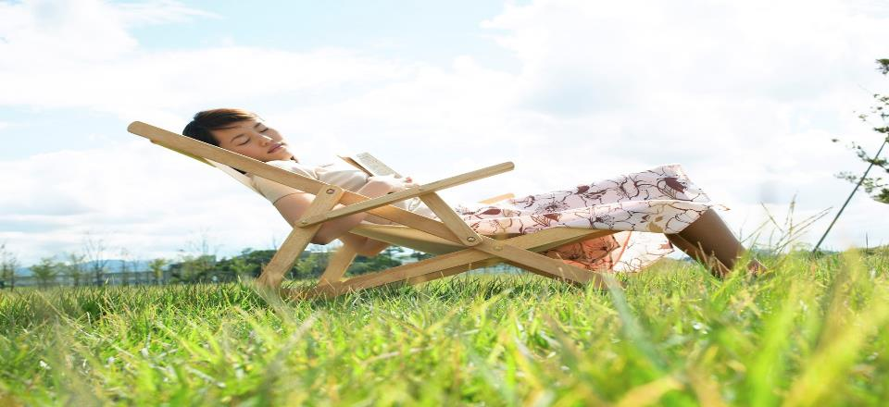
Bear in mind that the LORD has given you the Sabbath; that is why on the 6th day he gives you bread for two days. Everyone is to stay where they are on the 7th day; no one is to go out.”
So the people rested on the 7th day.

Slide 35

The people of Israel called the bread manna.
It was white like coriander seed and tasted like wafers made with honey.

Slide 36
The whole Israelite community set out from the Desert of Sin, traveling from place to place as the LORD commanded.
They camped at Rephidim, but there was no water for the people to drink.

Slide 37


So they quarreled with Moses and said,
Moses replied,
Give us water
to drink.
Why do you
quarrel with me?
Why do you put the
LORD to the test?

Slide 38

But the people were thirsty for water there, and they grumbled against Moses. They said, "Why did you bring us up out of Egypt to make us and our children and livestock die of thirst?"

Slide 39
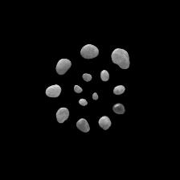
Then Moses cried out to the LORD,
What am I to do with these people? They are almost ready to stone me.

Slide 40
The LORD answered Moses,
“Go out in front of the people. Take with you some of the elders of Israel and take in your hand the staff with which you struck the Nile, and go.

Slide 41
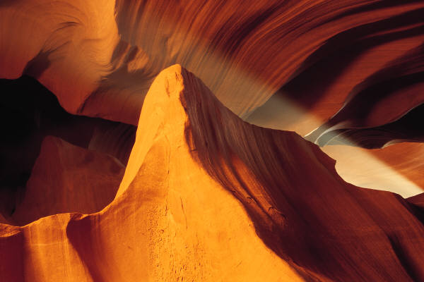
I will stand there before you by the rock at Horeb. Strike the rock, and water will come out of it for the people to drink.”
So Moses did this in the sight of the elders of Israel.

Slide 42
And he called the place Massah and Meribah because the Israelites quarreled and because they tested the LORD saying,
"Is the LORD among us or not?"

