Slide 1
Matthew
Dig Site 9
Matthew 13
Verses 1-23, 31-35, 44-46, 53-58

Slide 2

Hide it in your
Matthew6:33
DS#9

Slide 3
But seek first his kingdom
and his righteousness,
and all these things will be given
to you as well.
Matthew 6:33
DS#9

Slide 4

The Truth
Jesus wants us to understand His Kingdom, and He used parables to teach these truths.

Slide 5
The Kingdom of Heaven is like…

Slide 6
The Parable of the Sower and it’s meaning

Slide 7
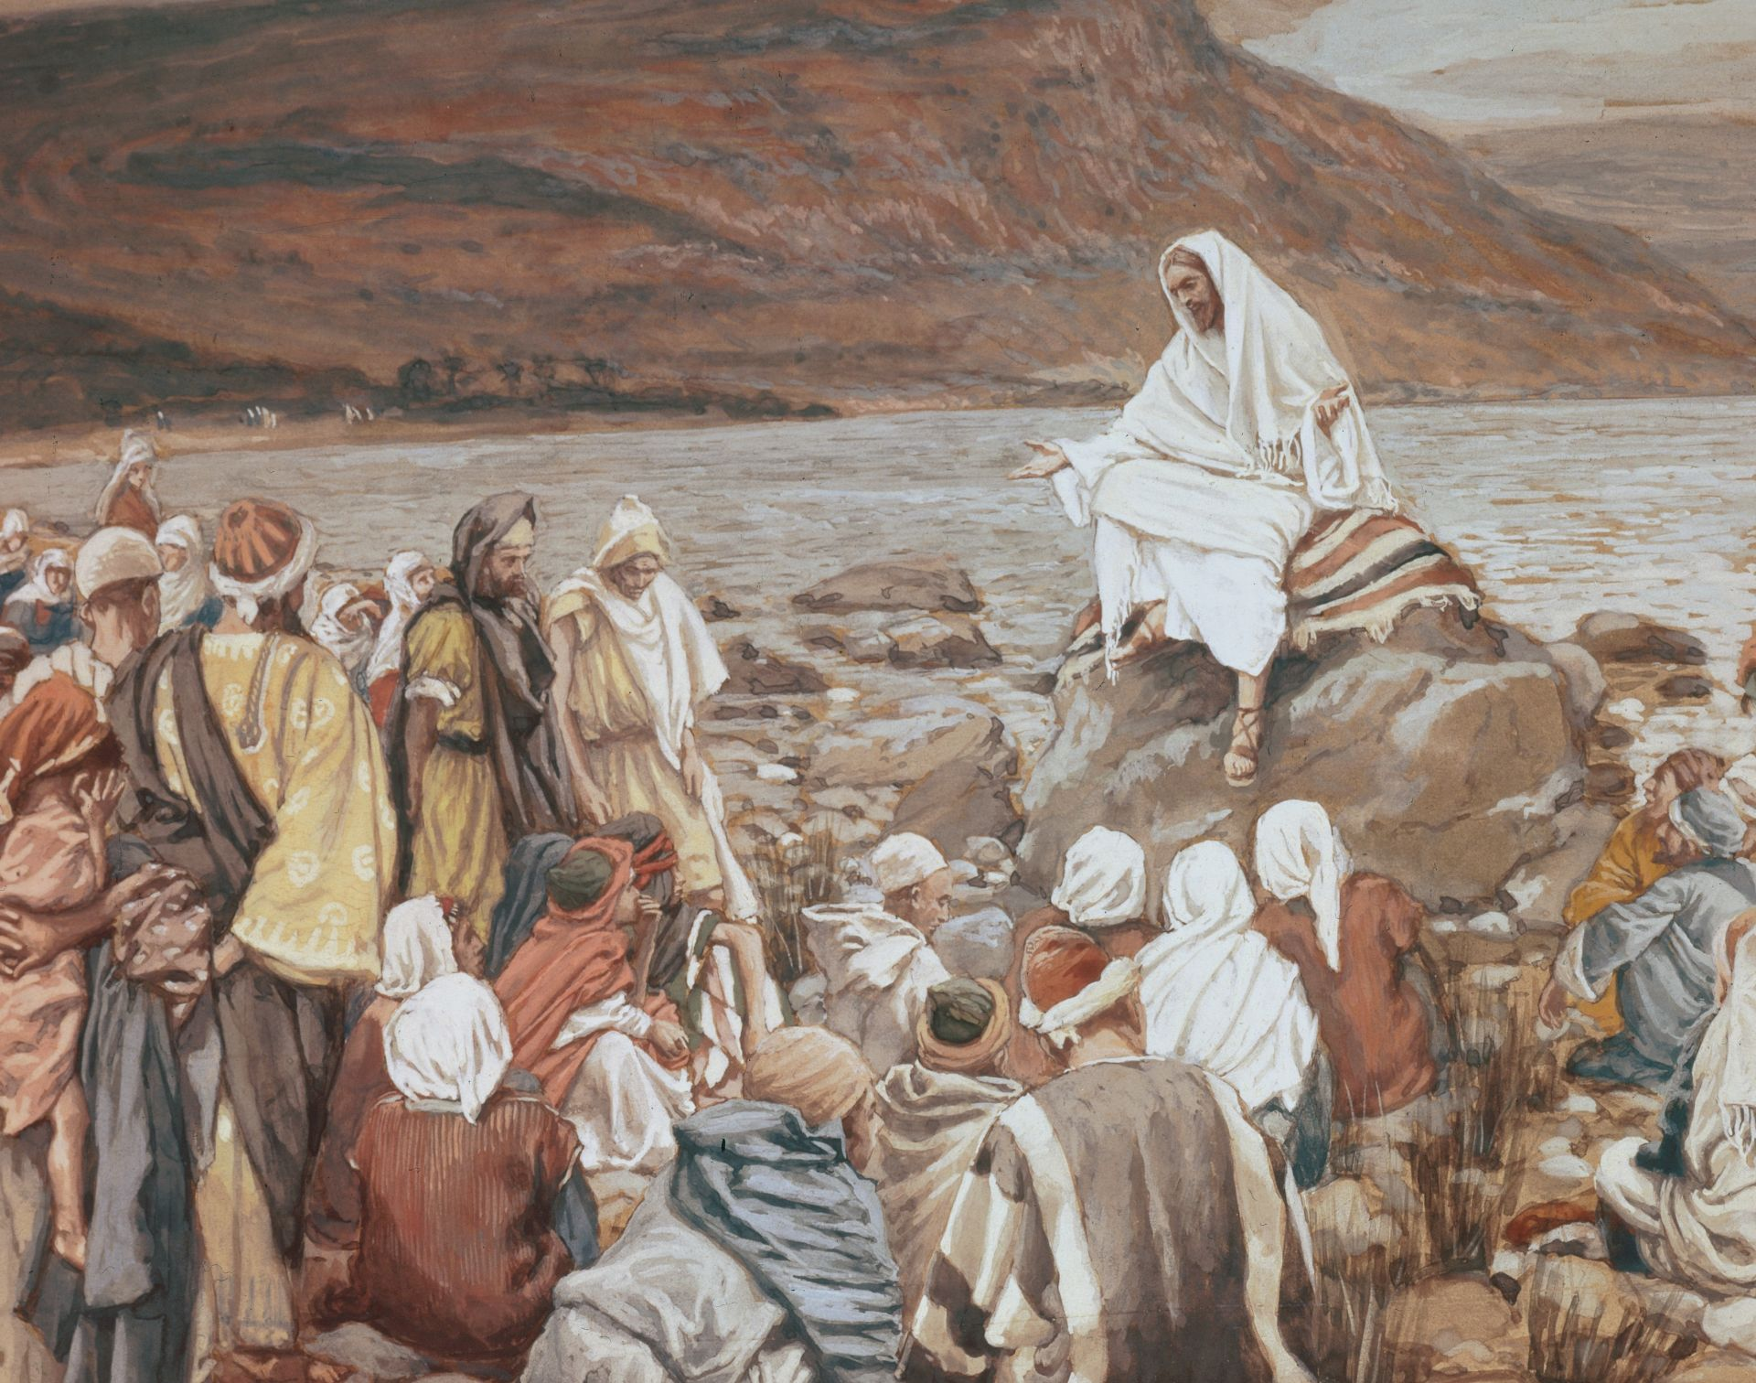
That same day Jesus went out of the house and sat by the lake.

Slide 8
Such large crowds gathered around him

Slide 9
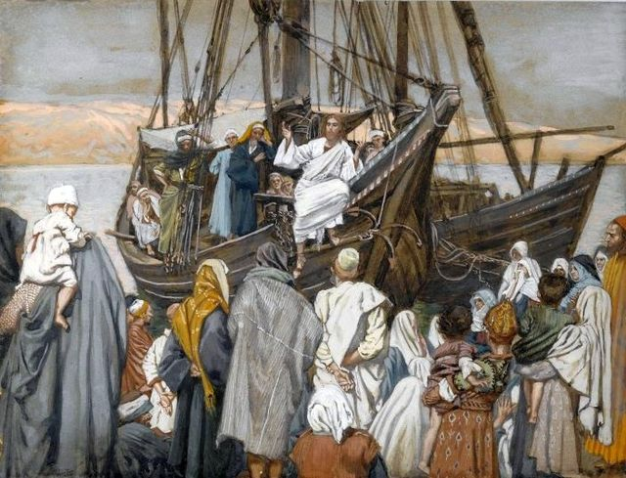
that he got into a boat and sat in it,
while all the people stood on the shore.

Slide 10

Then he told them many things in parables, saying: “A farmer went out to sow his seed.

Slide 11
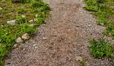
and the birds came and ate it up.

Slide 12
As he was scattering the seed,
some fell along the path,

Slide 13
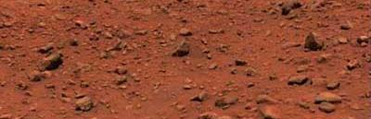
Some fell on rocky places, where it did not have much soil.

Slide 14
It sprang up quickly, because the soil was shallow.

Slide 15

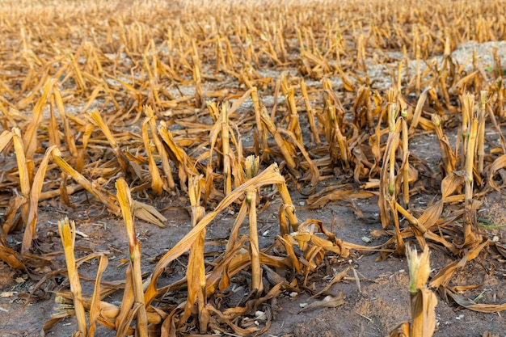
But when the sun came up,
the plants were scorched,
and they withered because they had no root.

Slide 16
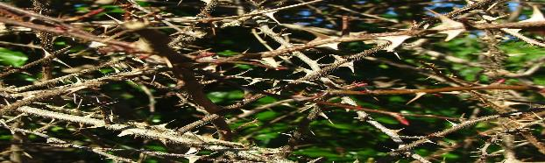
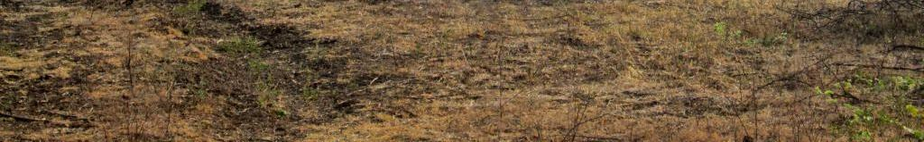
Other seed fell among thorns,
which grew up and choked the plants.

Slide 17
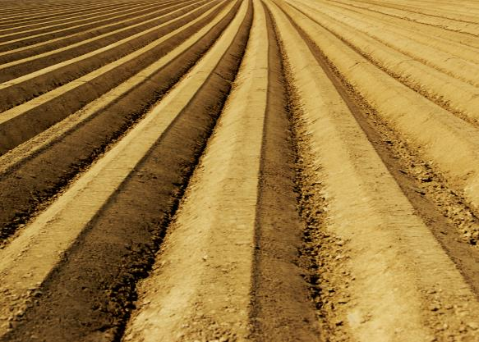
Still other seed fell on good soil,

Slide 18

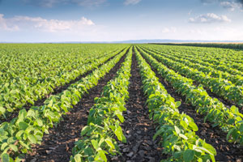
where it produced a crop — a hundred

Slide 19
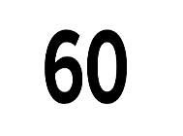
sixty

Slide 20

or thirty times what was sown.

Slide 21

Whoever has ears, let him hear.”

Slide 22
The disciples came to him and asked,
“Why do you speak to the people in parables?”

Slide 23
He replied, “Because the knowledge of the secrets of the kingdom of heaven has been given to you, but not to them. Whoever has will be given more, and they will have an abundance.

Slide 24
Whoever does not have, even what they have will be taken from them.
This is why I speak to them in parables:

Slide 25
“Though seeing,

Slide 26
they do not see;

Slide 27
though hearing

Slide 28

they do not hear or understand.

Slide 29
In them is fulfilled the prophecy of Isaiah:
“You will be ever hearing

Slide 30
but never understanding;”

Slide 31
you will be ever seeing

Slide 32

but never perceiving.
X
<a href="https://www.flaticon.com/free-icons/perception" title="perception icons">Perception icons created by Freepik - Flaticon</a>

Slide 33

.
For this people’s heart has become calloused;

Slide 34

they hardly hear with their ears,

Slide 35
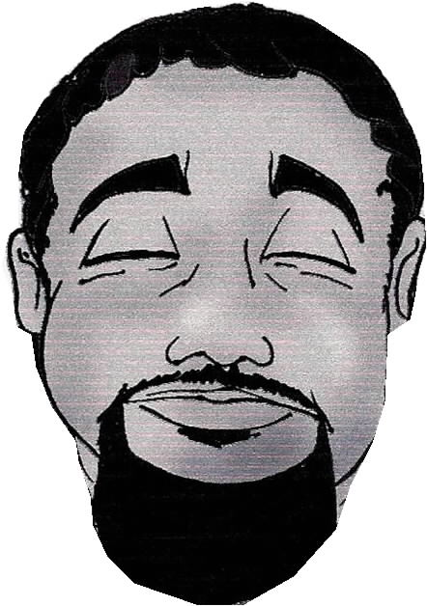
and they have closed their eyes.

Slide 36
Otherwise, they might see with their eyes,
hear with their ears,

Slide 37

understand with their heart and turn,
and I would heal them.’

Slide 38

But blessed are your eyes because they see,
and your ears because they hear.
For truly I tell you, many prophets and righteous people longed to see what you see
but did not see it, and to hear what you hear
but did not hear it.

Slide 39
“Listen then to what the
parable of the sower means:
When anyone hears the message about the kingdom and does not understand it,

Slide 40

the evil one comes and snatches away what was sown in their heart.
This is the seed sown along the path.

Slide 41
The seed falling on rocky ground refers to someone who hears the word and at once receives it with joy.

Slide 42
But since they have no root,
they lasts only a short time.
When trouble or persecution comes
because of the word,
they quickly fall away.

Slide 43

The seed falling among the thorns refers to someone who hears the word, but the worries of this life and the deceitfulness of wealth choke the word,
making it unfruitful.
WORD

Slide 44


But the seed falling on good soil refers to someone who hears the word and understands it. This is the one who produces a crop, yielding a hundred, sixty or thirty times what was sown.”

Slide 45
The Parables of the Mustard Seed and the Yeast

Slide 46

He told them another parable: “The kingdom of heaven is like a mustard seed, which a man took and planted in his field.

Slide 47
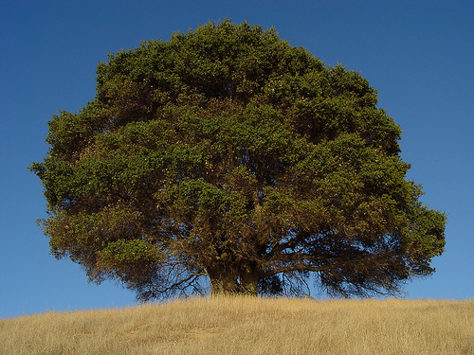
Though it is the smallest of all seeds, yet when it grows, it is the largest of garden plants

Slide 48
and becomes a tree, so that the birds come and perch in its branches.”

Slide 49
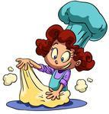
He told them still another parable:
“The kingdom of heaven is like yeast that a woman took and mixed into about 60 pounds of flour until it worked all through the dough.”

Slide 50
The Parables of the Hidden Treasure and Pearl

Slide 51
Jesus spoke all these things to the crowd in parables; he did not say anything to them without using a parable.

Slide 52
So was fulfilled what was spoken
through the prophet:
“I will open my mouth in parables,
I will utter things hidden
since the creation of the world.”

Slide 53
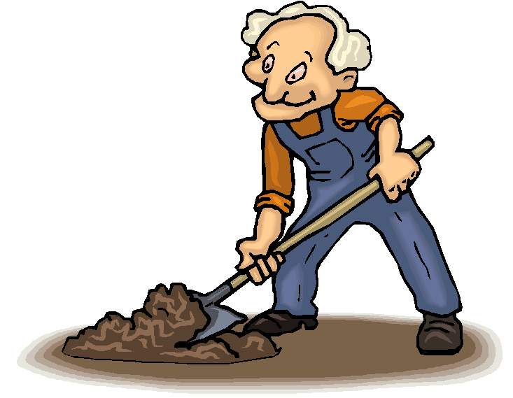

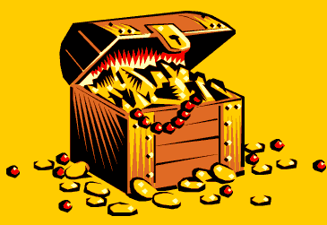
“The kingdom of heaven is like treasure hidden in a field.
When a man found it, he hid it again,
and then in his joy went and
sold all he had and bought that field.

Slide 54

“Again, the kingdom of heaven is like a merchant looking for fine pearls. When he found one of great value, he went away and sold everything he had and bought it.

Slide 55
A Prophet without Honor

Slide 56
When Jesus had finished these parables, he moved on from there.

Slide 57

to his hometown, he began teaching the people in their synagogue, and they were amazed.

Slide 58
“Where did this man get this wisdom and these miraculous powers?” they asked.
“Isn’t this the carpenter’s son?
Isn’t his mother’s name Mary, and
aren’t his brothers James, Joseph, Simon and Judas?

Slide 59
Aren’t all his sisters with us?
Where then did this man get all these things?”

Slide 60

And they took offense at him.

Slide 61
But Jesus said to them,
“A prophet is not without honor except in his own town and in his own home.”

Slide 62
And he did not do many miracle there
because of their lack of faith.
NO MIRACLES HERE……….

